Slide 1
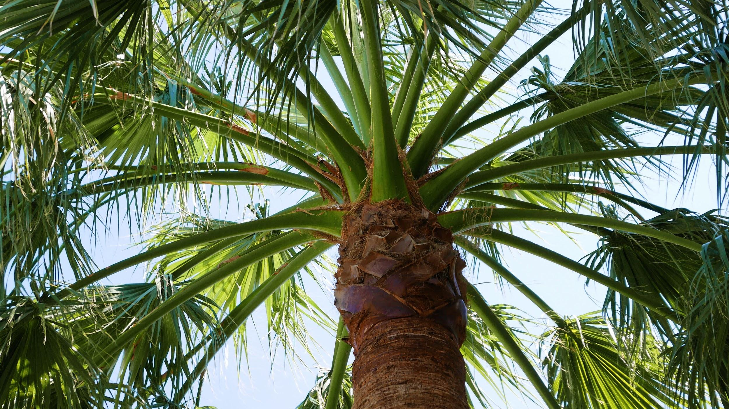
PALM OIL
We will explain how palm oil production affects ecosystems.
Notes:
Insert cover image and use transparency settings to fade image.

Slide 2
Do not delete this slide.
This slide is designed so that you can copy the prompt box you need and insert it into your slides.
This slide is hidden and will not be included when presenting your lesson.
TRACK WITH ME
CHECK FOR UNDERSTANDING
VOCABULARY
1 -
HINT
Students, remember….
READ WITH ME
TEACHER CUE
MAKE THE CONNECTION
Students, you already know….
EXTENSION

Slide 3
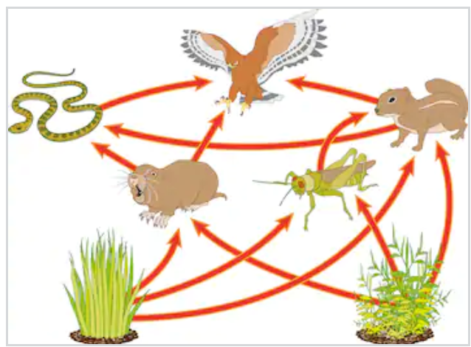
Write 3 food chains from the food web below.

Slide 4
Repeat the opposite word/phrase.
VERTEBRATE
HAS A BACKBONE

Slide 5
Repeat the opposite word/phrase.
INVERTEBRATE
HAS NO BACKBONE

Slide 6
Repeat the opposite word/phrase.
FOOD CHAIN
HOW ENERGY TRANSFERRED BETWEEN ORGANISMS

Slide 7
Repeat the opposite word/phrase.
FOOD WEB
INTERACTIONS BETWEEN ORGANISMS IN AN ENVIRONMENT

Slide 8
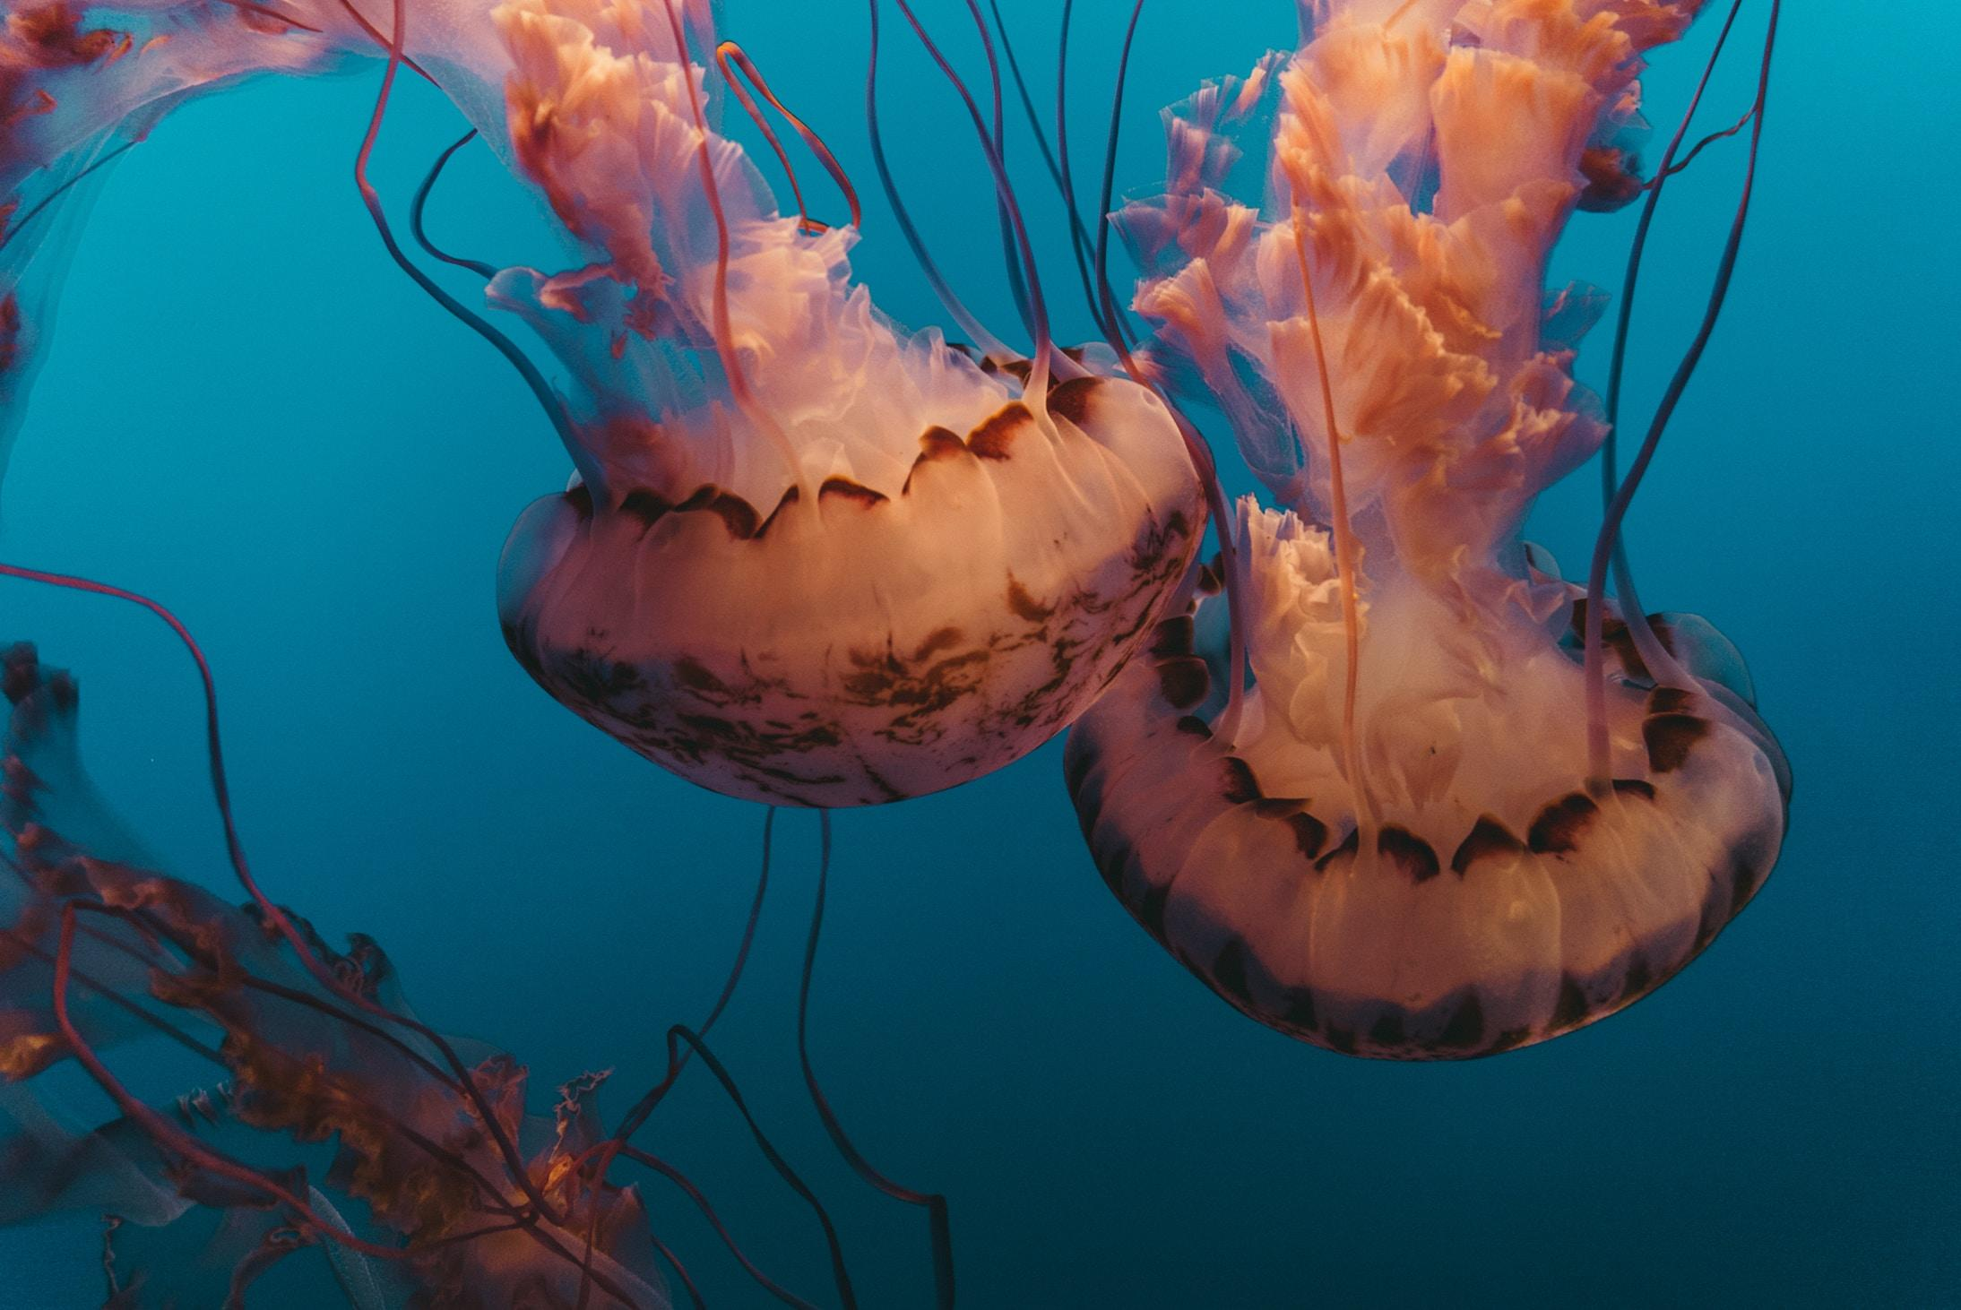
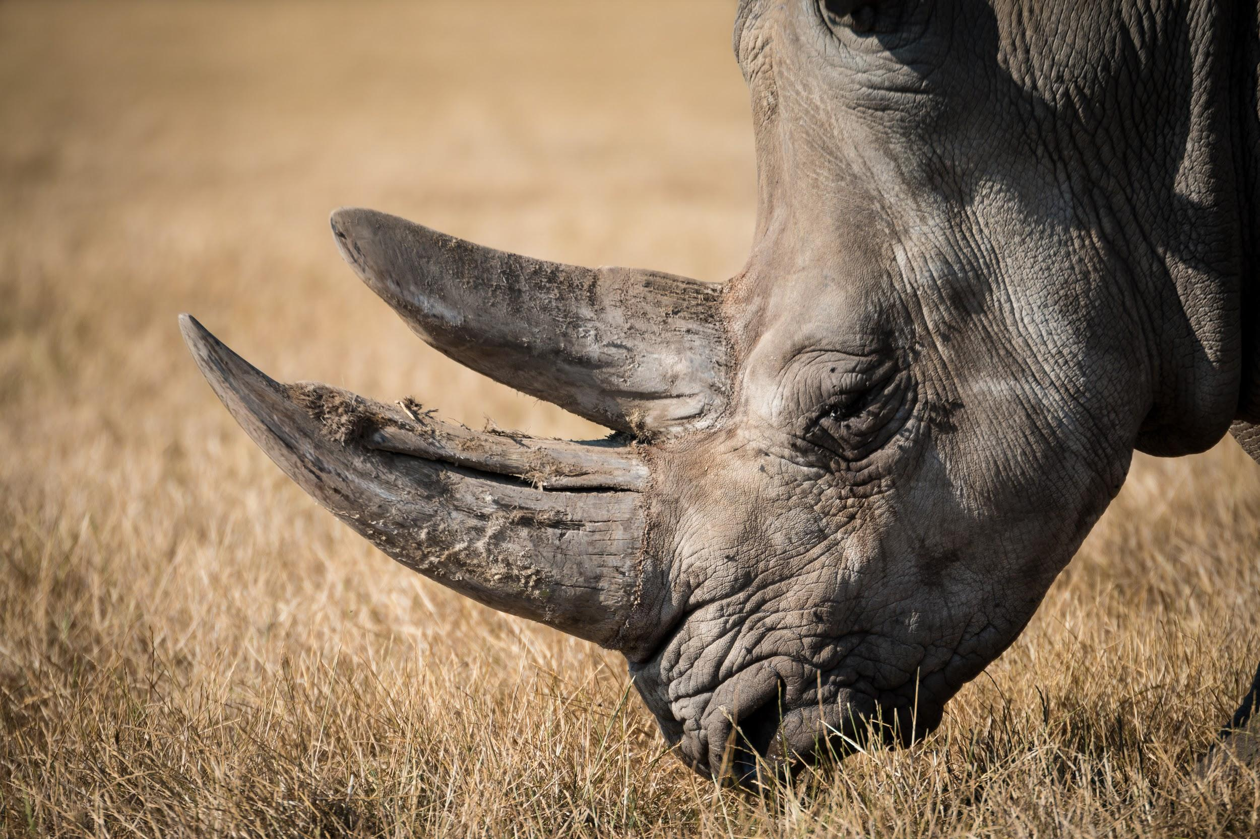
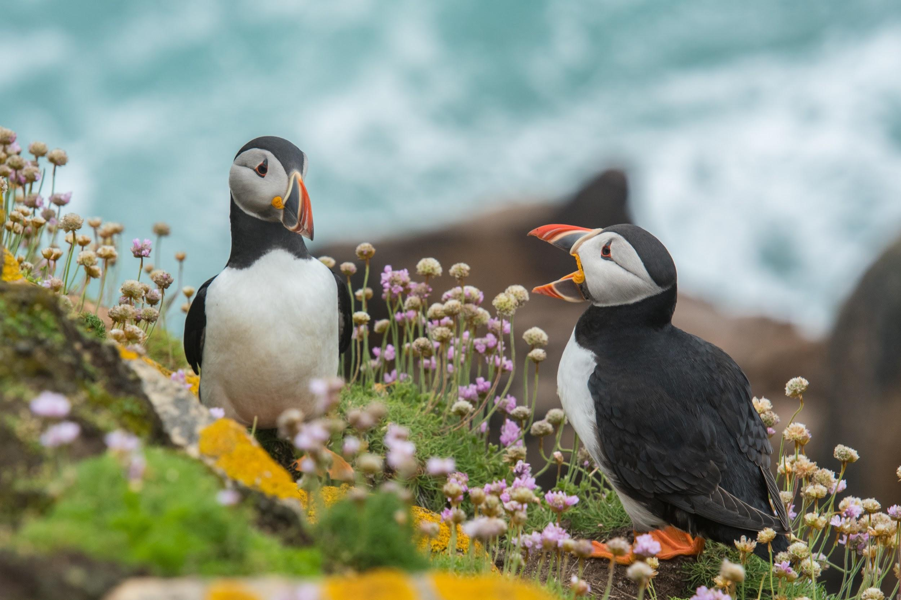
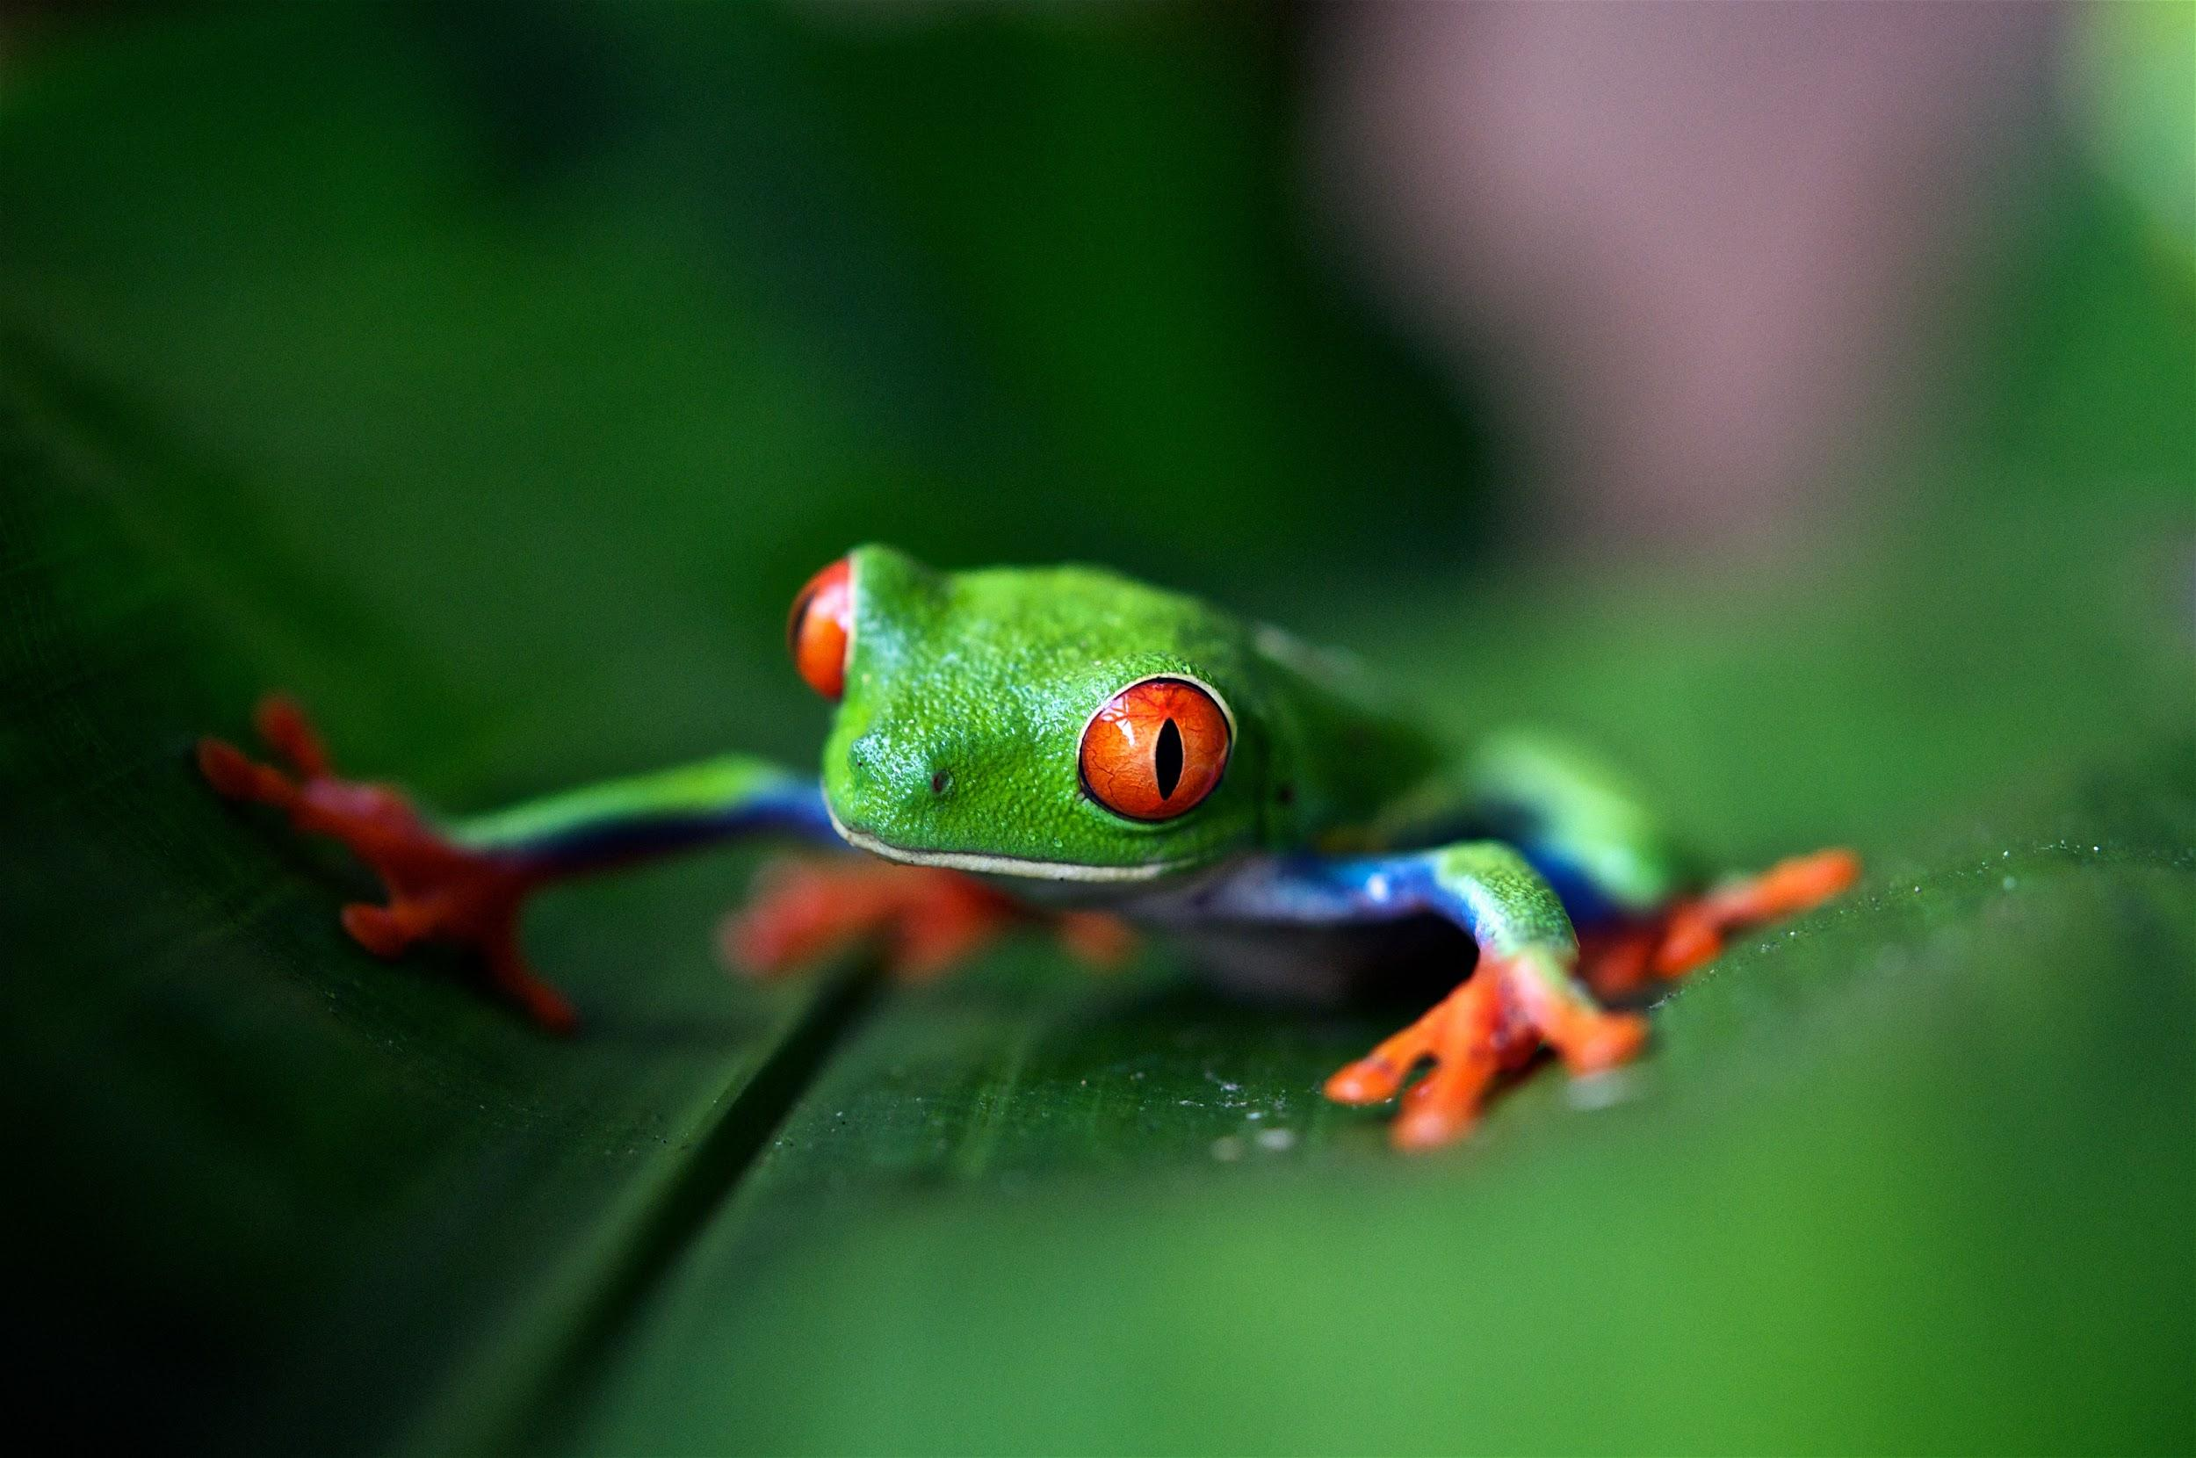
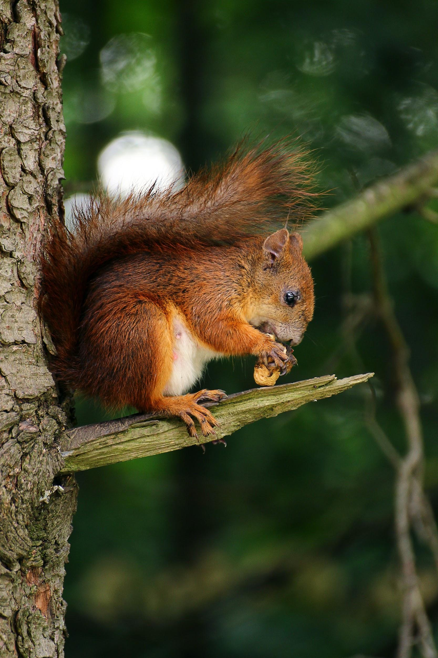
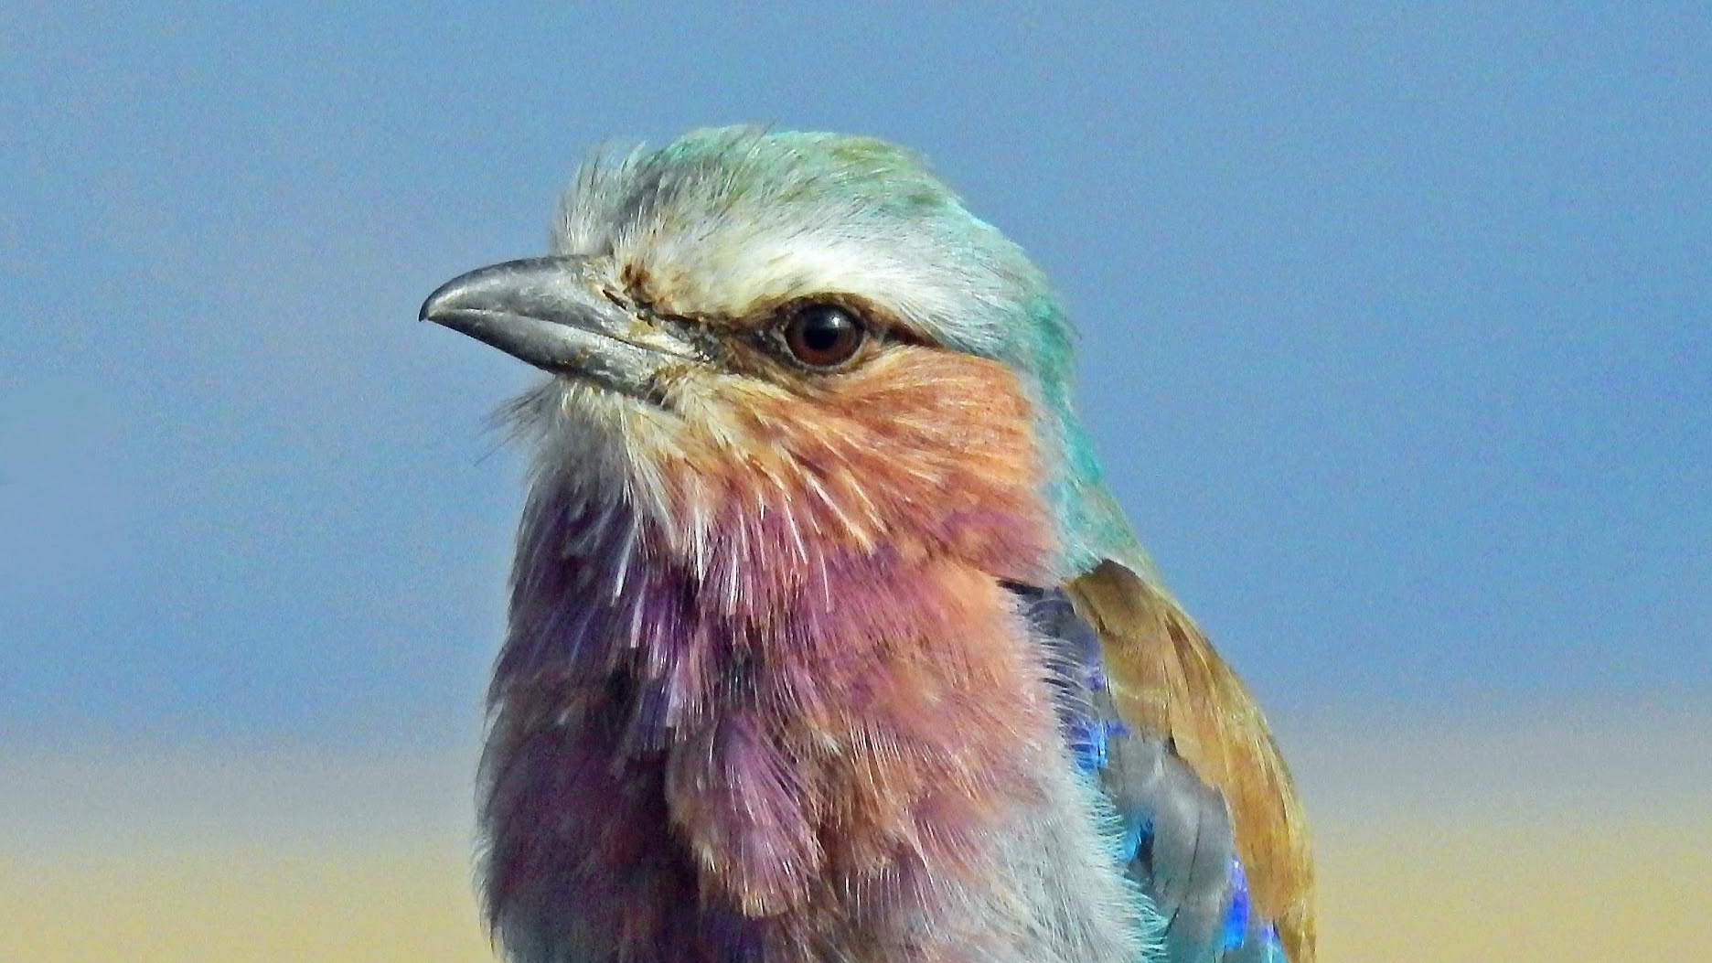
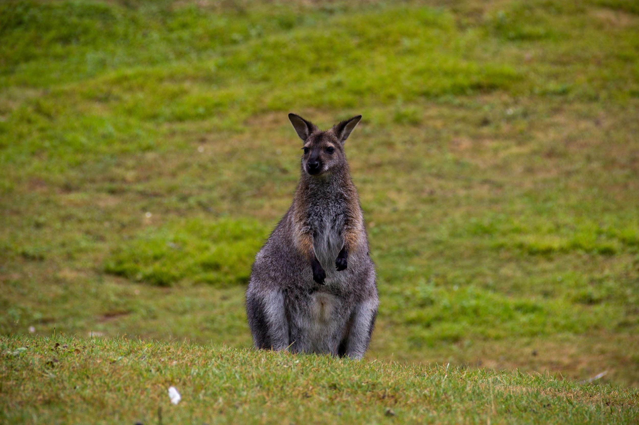
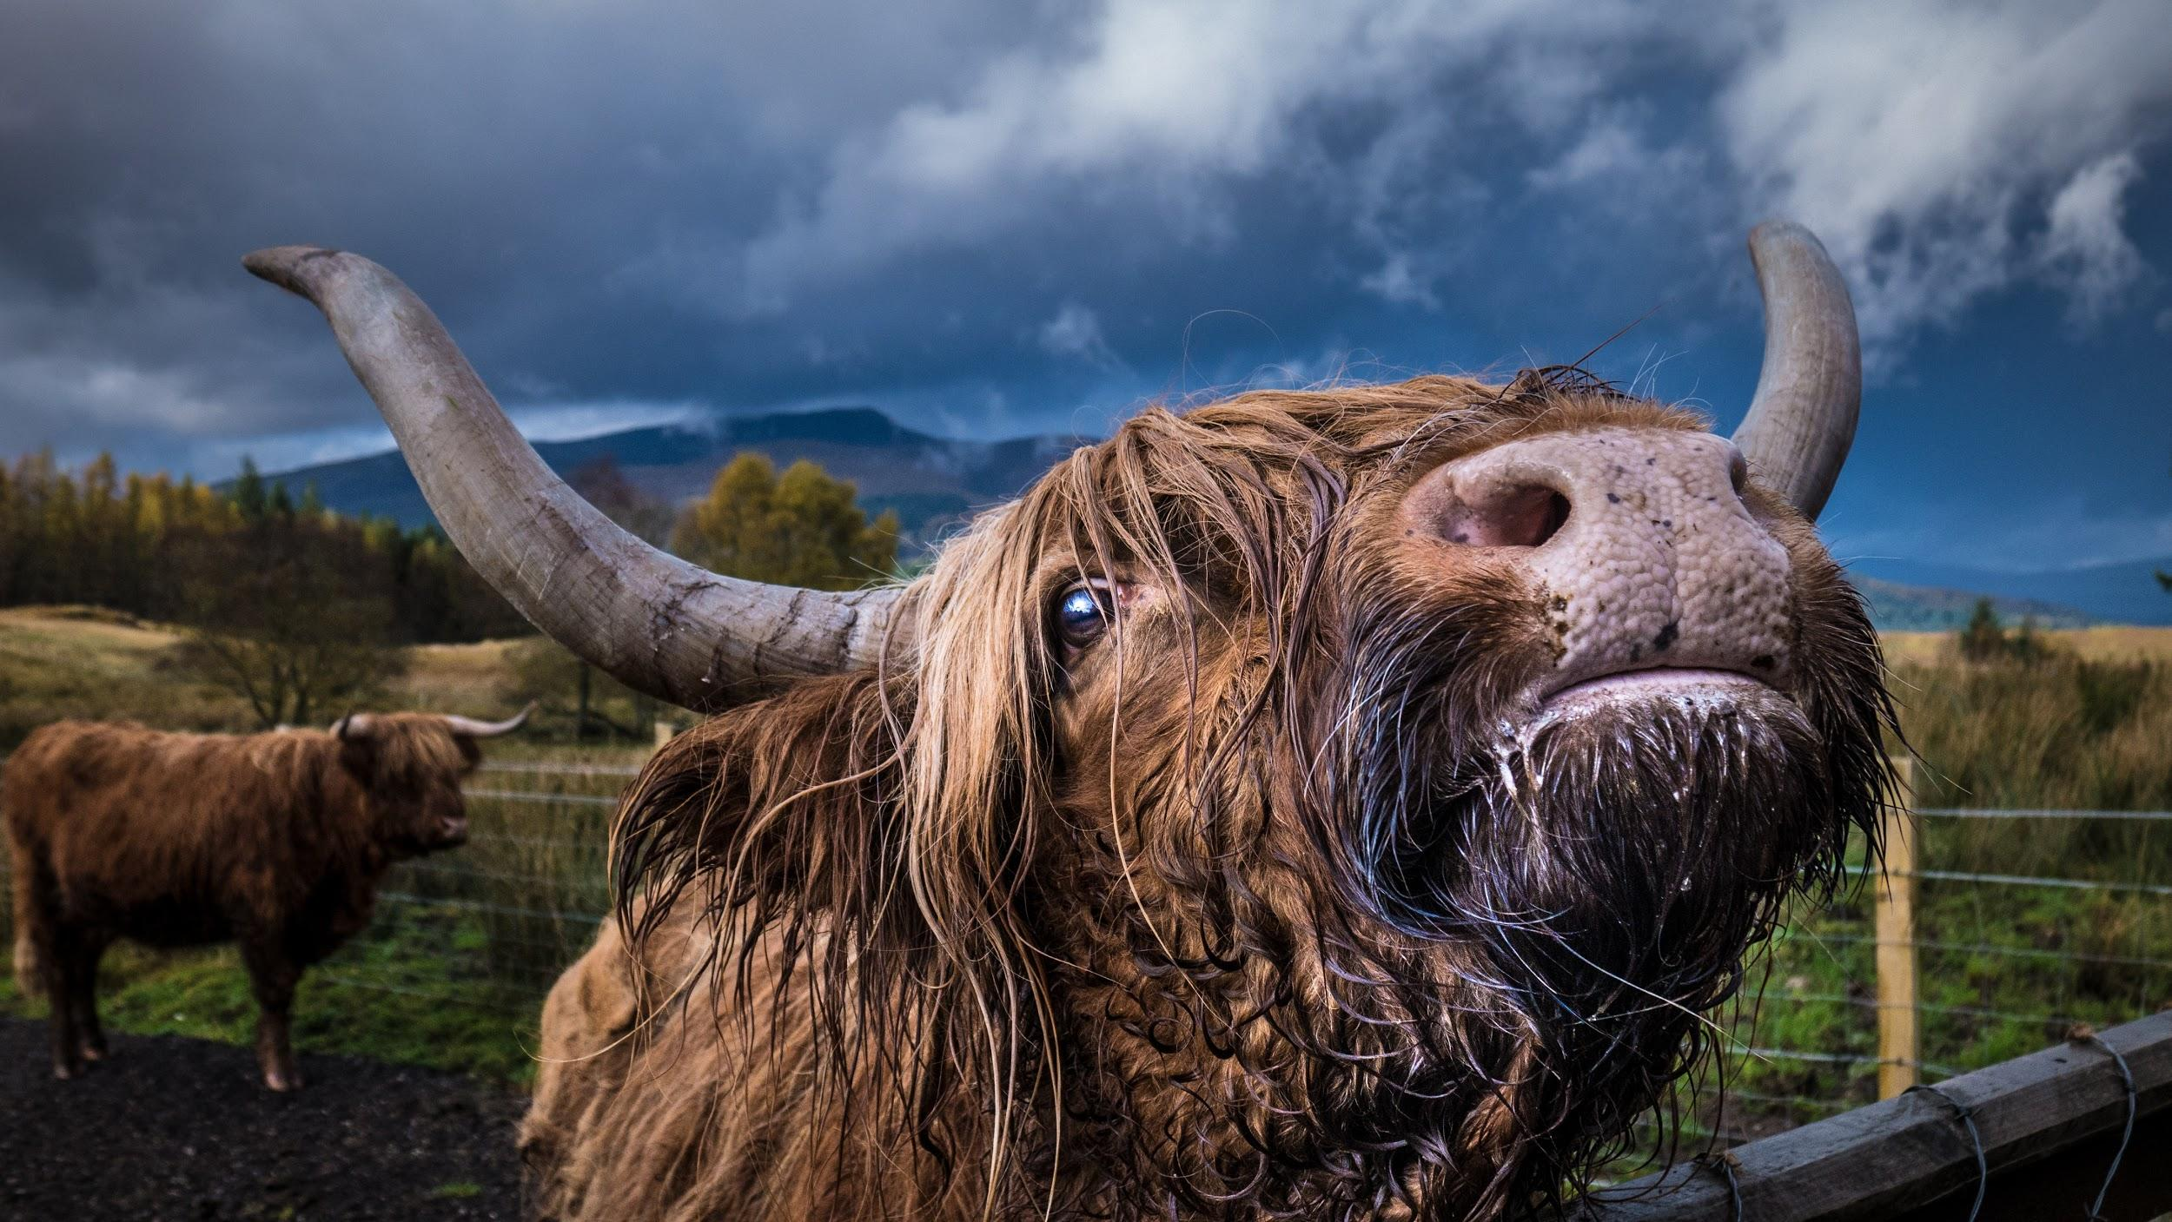
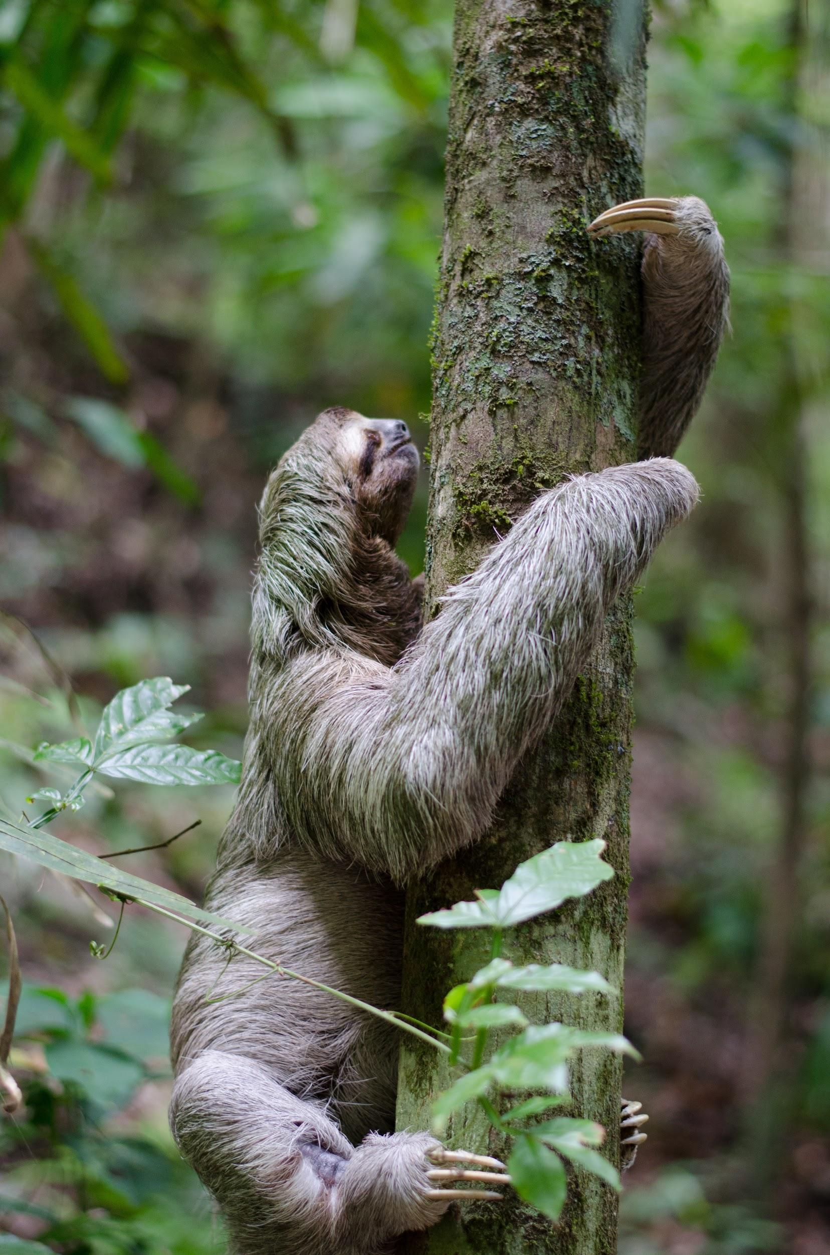
What are some observable features for the following creatures?

Slide 9
We will explain how palm oil production affects ecosystems.
TRACK WITH ME
READ WITH ME
We will identify the impacts of palm oil production in Sumatra & Borneo.
We will use examples of food webs and how ecosystems are affected by palm oil production.
DECLARE THE OBJECTIVE
Read the learning objective to your partner.
Notes:
Learning Objectives contain concepts (nouns, big ideas), skills (verbs, measurable behaviours) and sometimes context (restricting or targeting conditions).
●Example: Students will be able to describe the concept of density and apply it to floating and sinking.
●
Success criteria are specific measurable outcomes that if met mean that the student has met the learning objective.
Examples:
•Students will be able to compare densities of substances using mass and volume.
•Students will be able to identify whether a solid or liquid will float or sink in a liquid based on their densities.

Slide 10
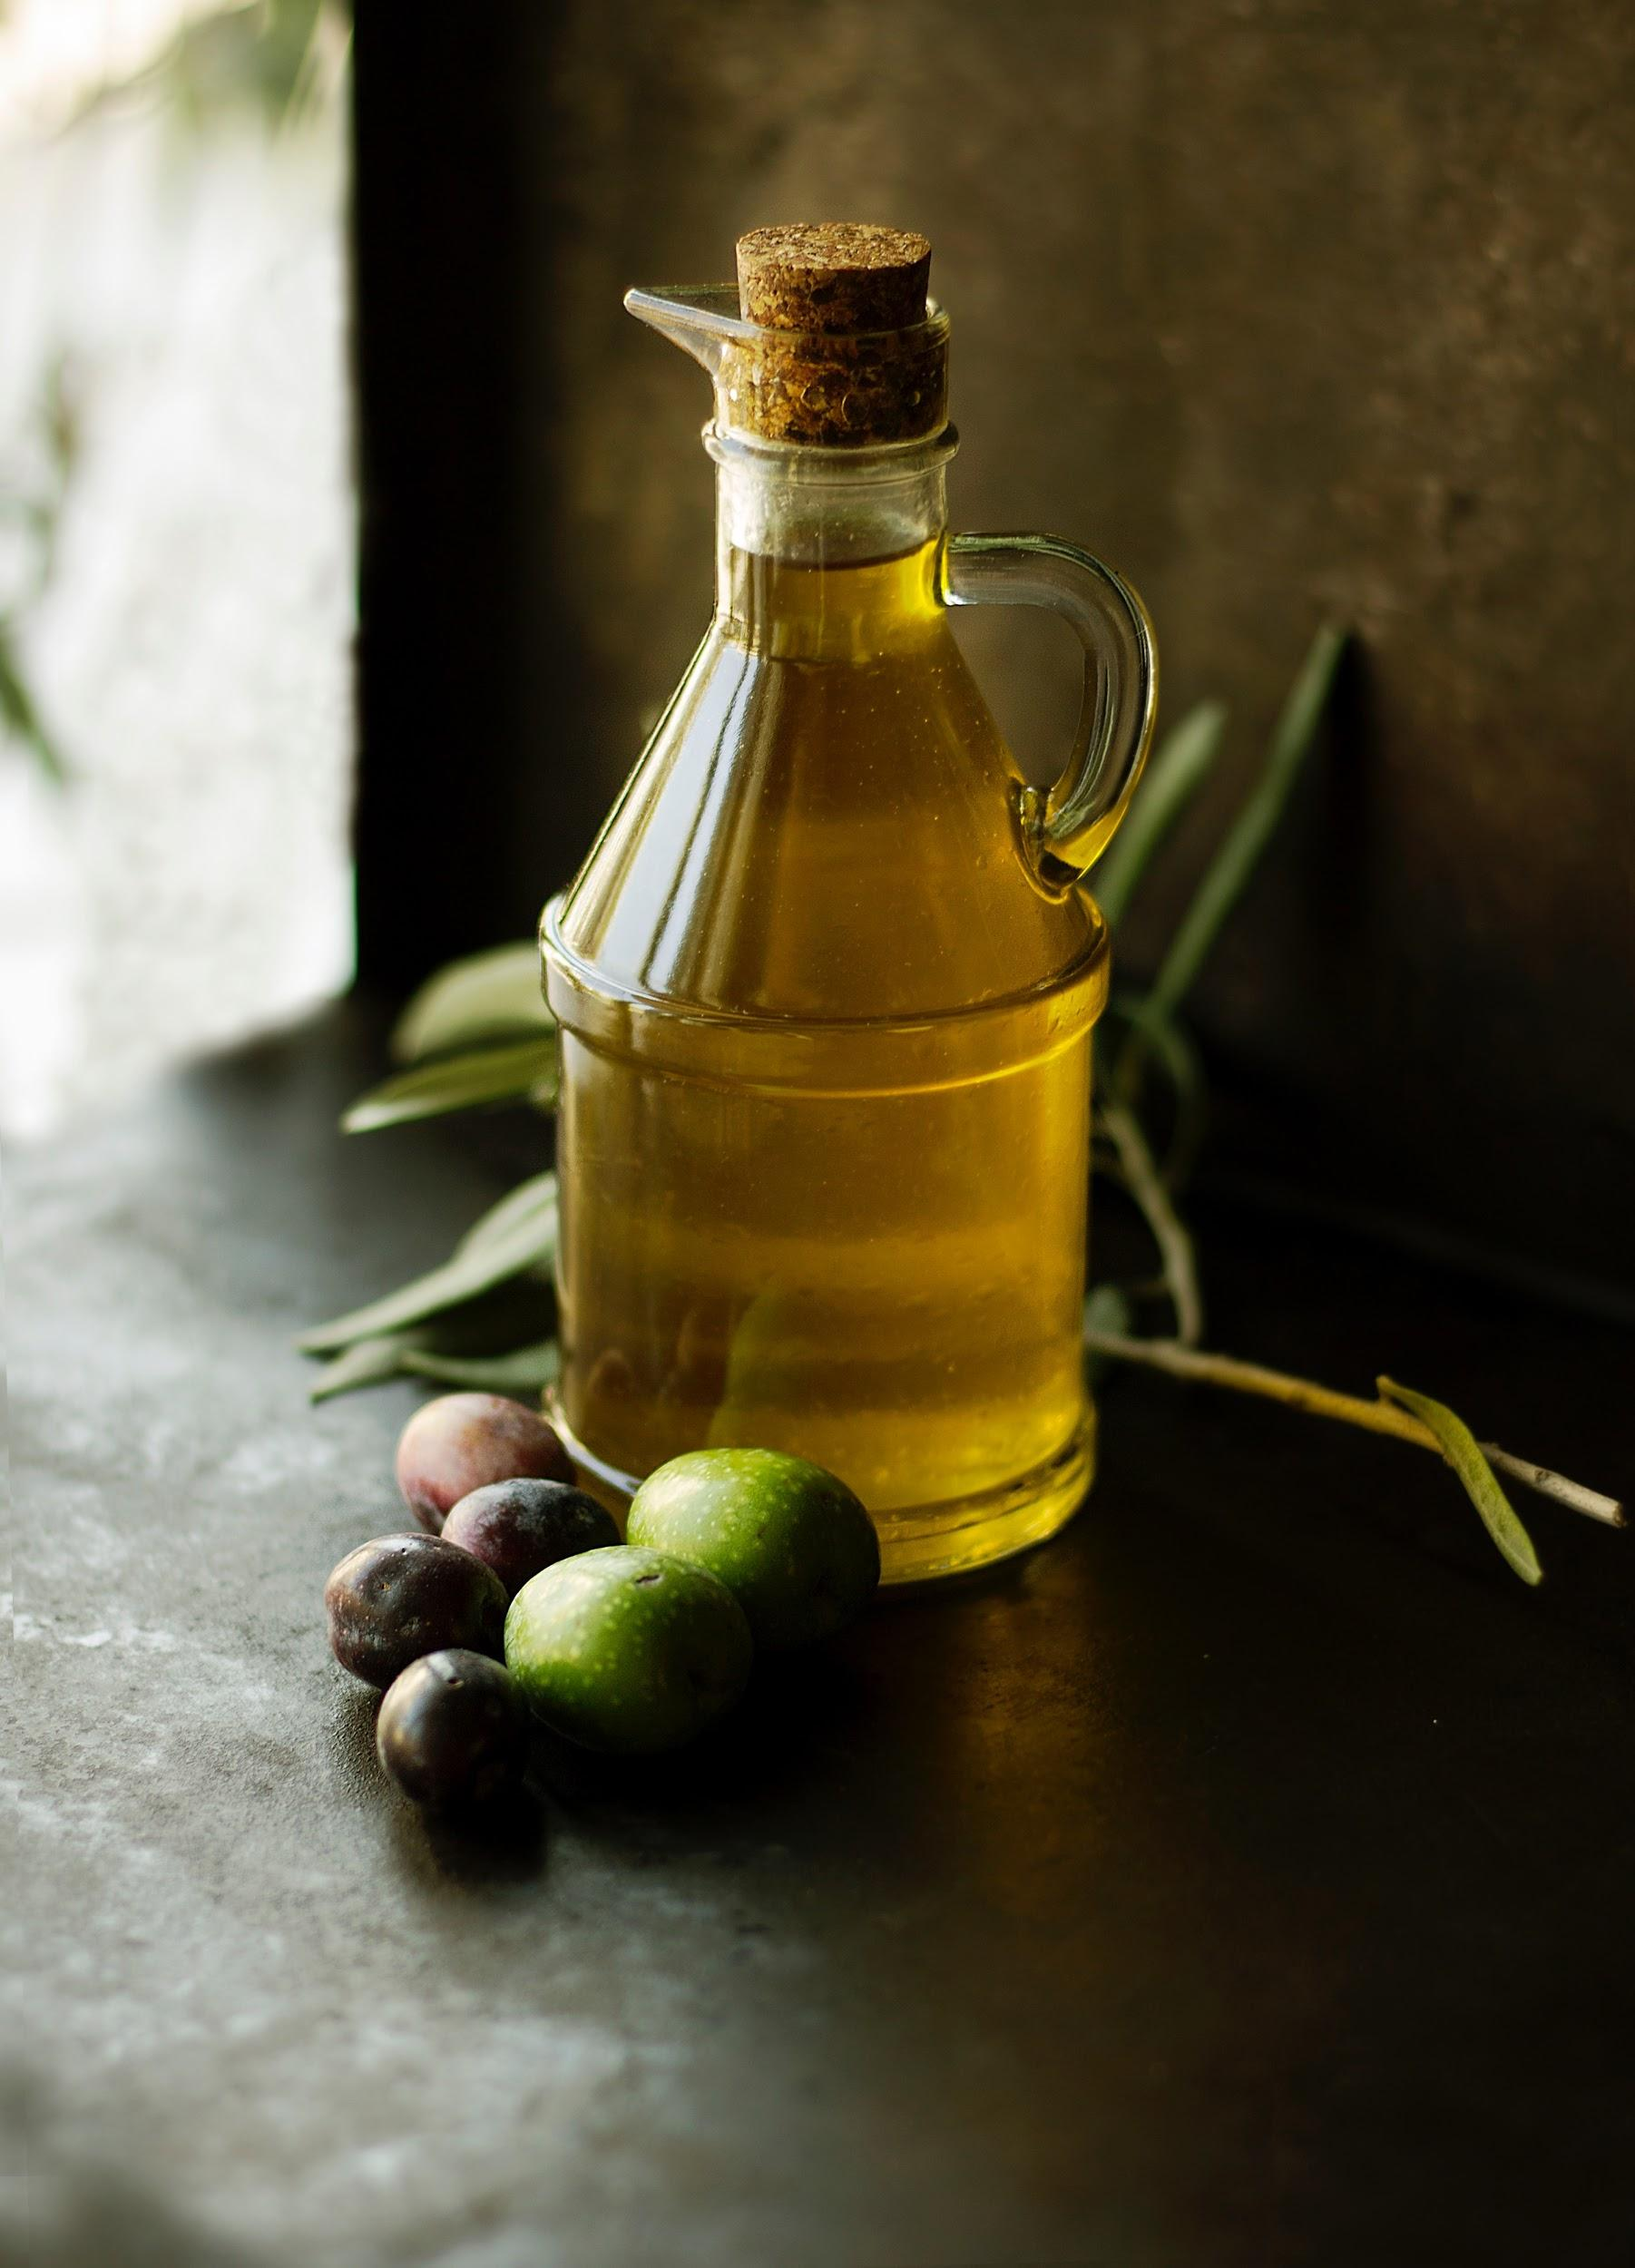
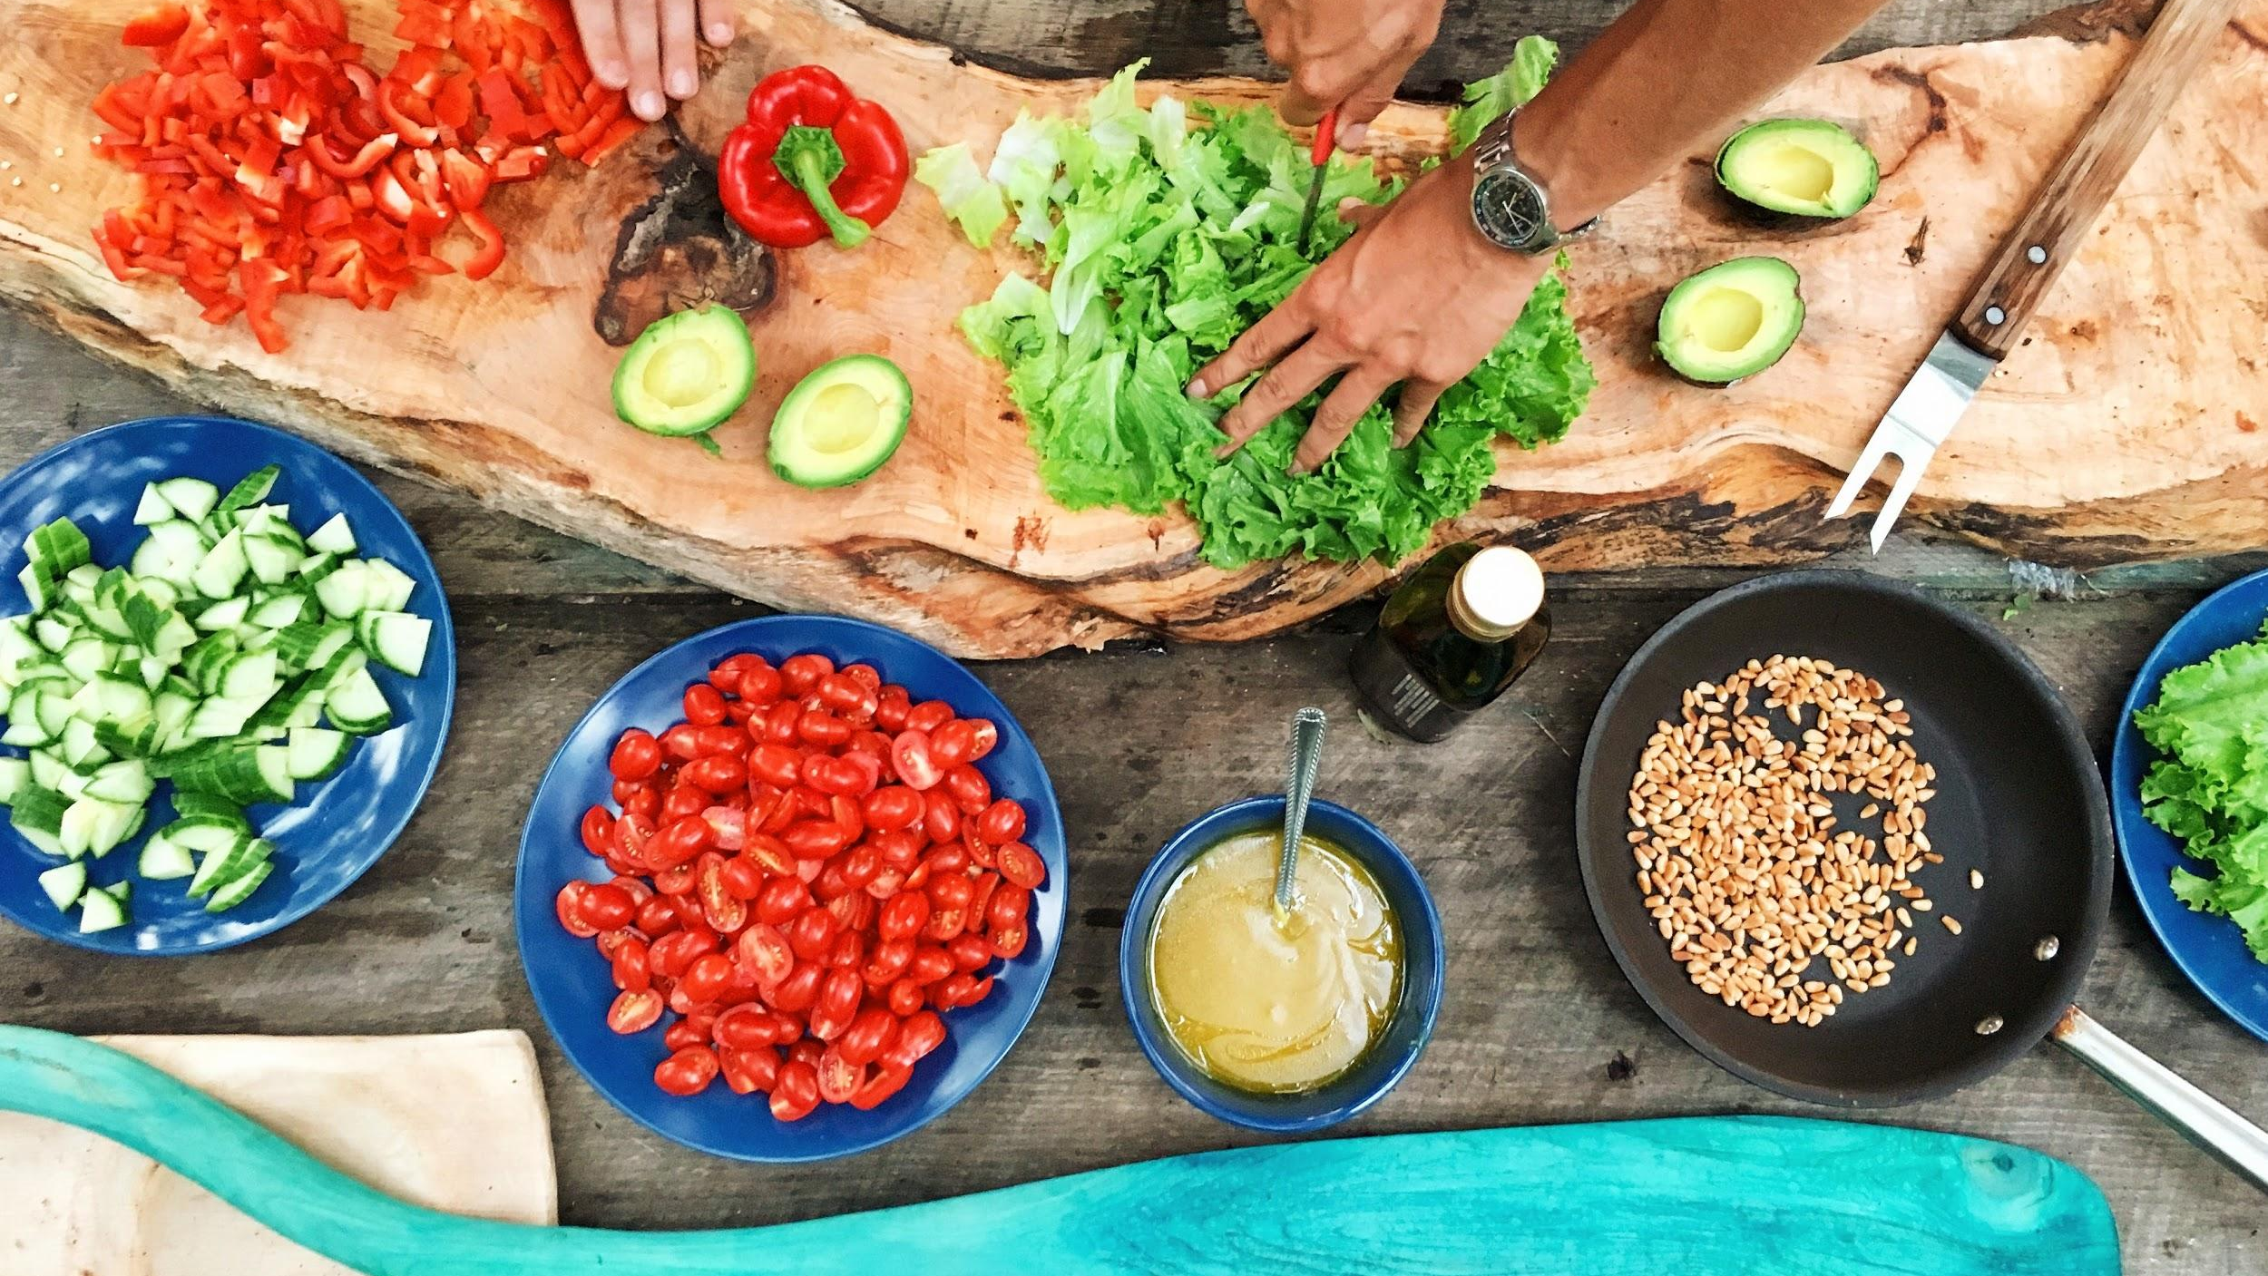
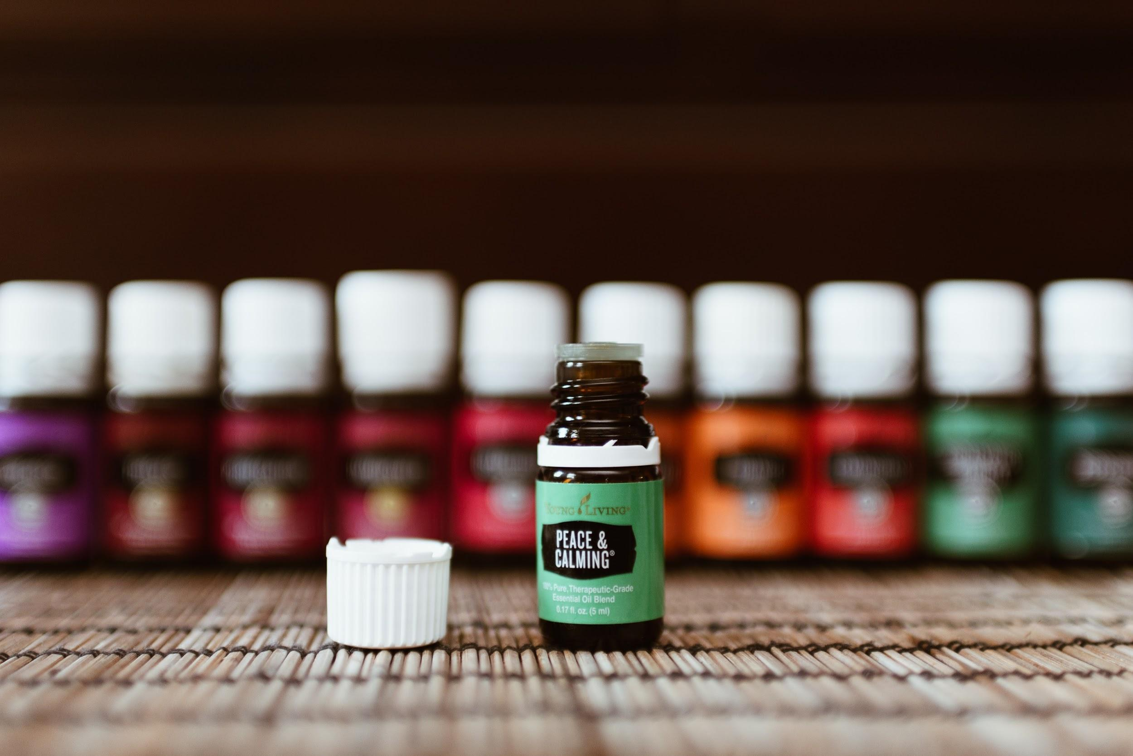
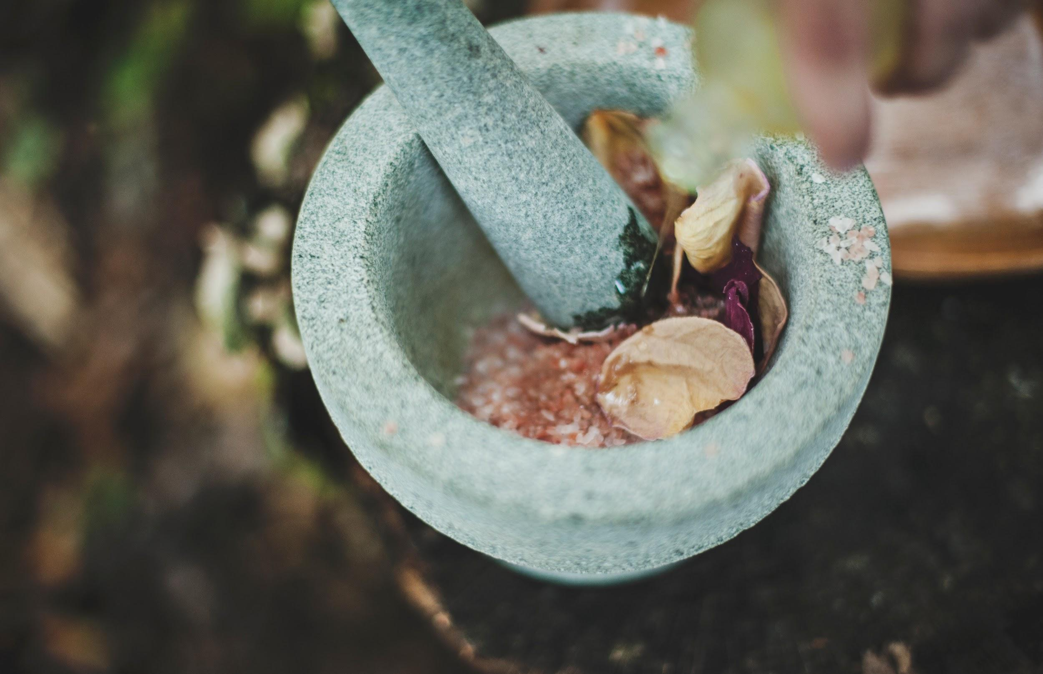
We will explain how palm oil production affects ecosystems.
Oils are used for many different purposes. From cooking to cleaning and personal hygiene, oils have become a fundamental part of our daily lives.
In what ways do you use oils in your daily lives?
MAKE THE CONNECTION
Students, you already know that oils are used in painting, cooking, cleaning, hygiene and fueling our vehicles.

Slide 11
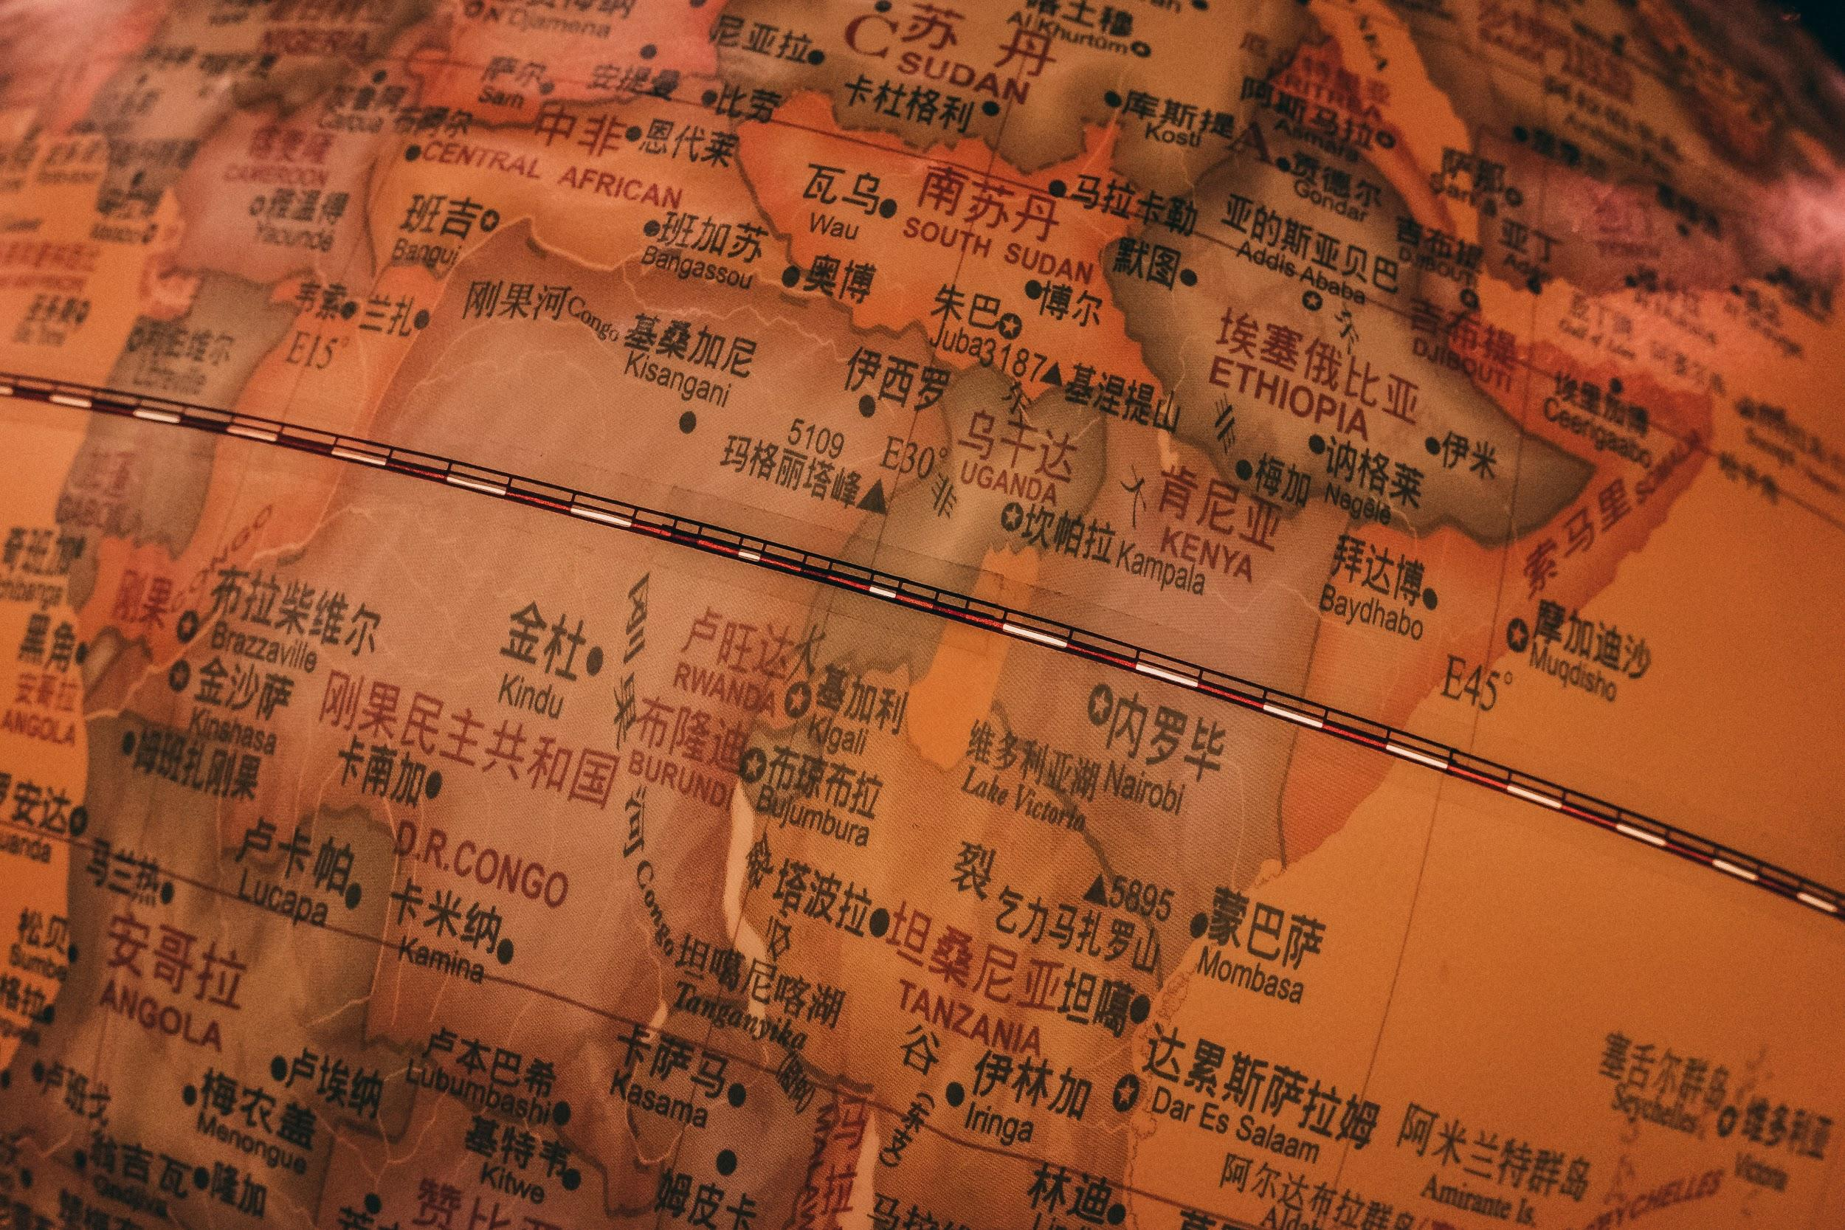
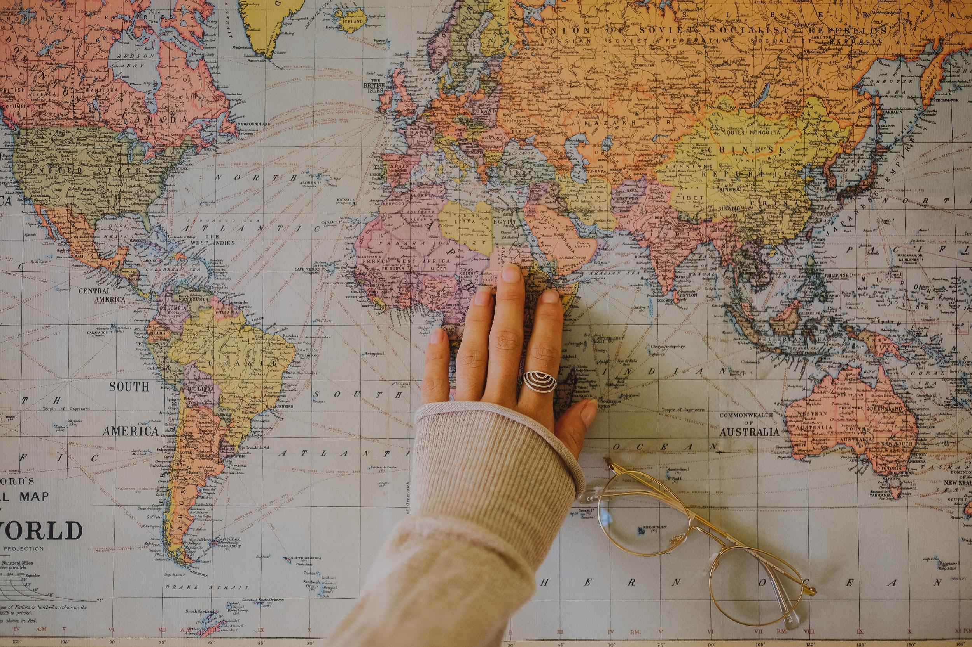
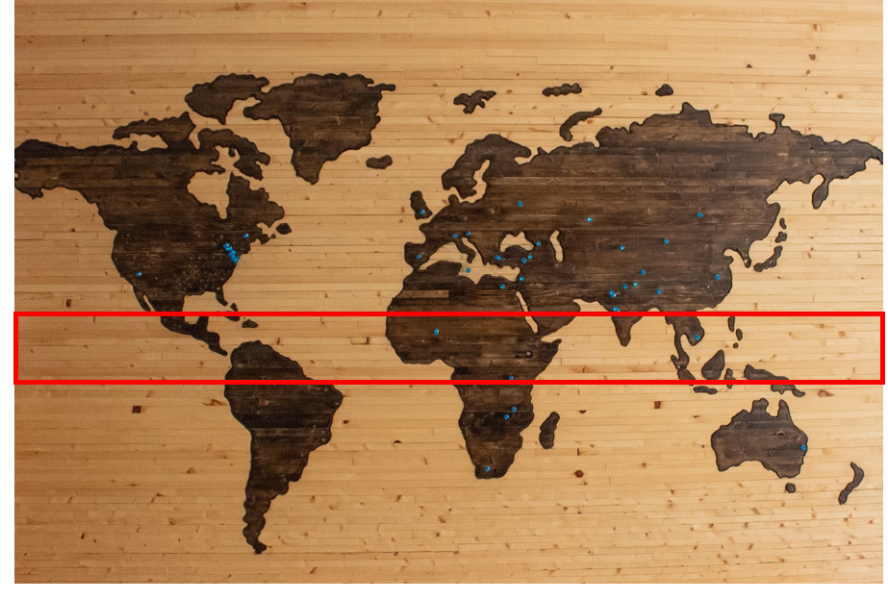
We will explain how palm oil production affects ecosystems.
CHECK FOR UNDERSTANDING
In what conditions do oil palms grow? Cold, Polar Climates Warm, Tropical Climates Temperate, Steady Climates
Originating in West Africa, palm oil comes from a plant (oil palms) that only grows in the tropical climates 10 degrees north or south of the equator.
Globalization₁ has lead to palm oil plantations spread from the African continent and into Indonesia, Malaysia, Thailand.
VOCABULARY
1 - business and technology spreading internationally

Slide 12
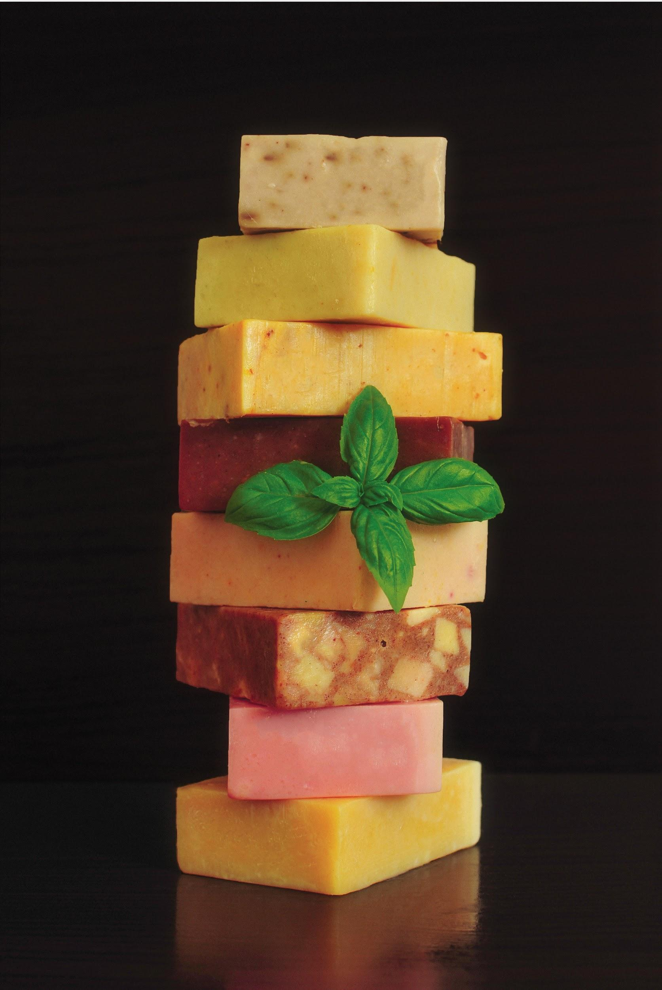
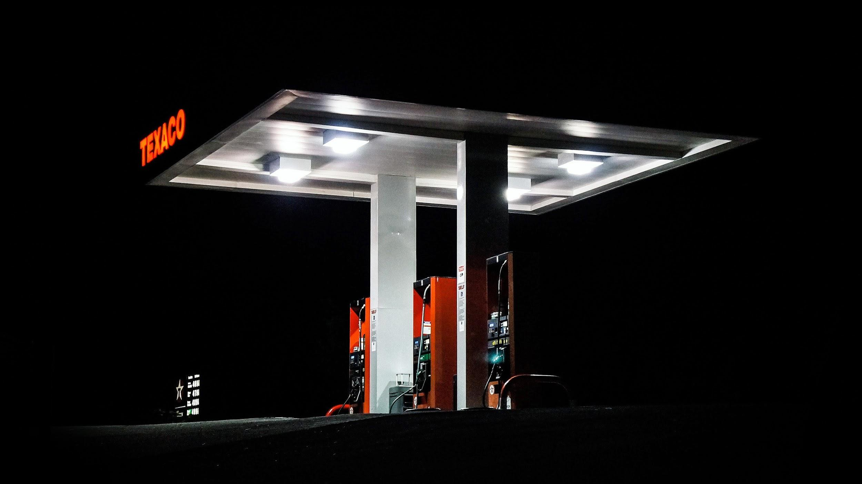
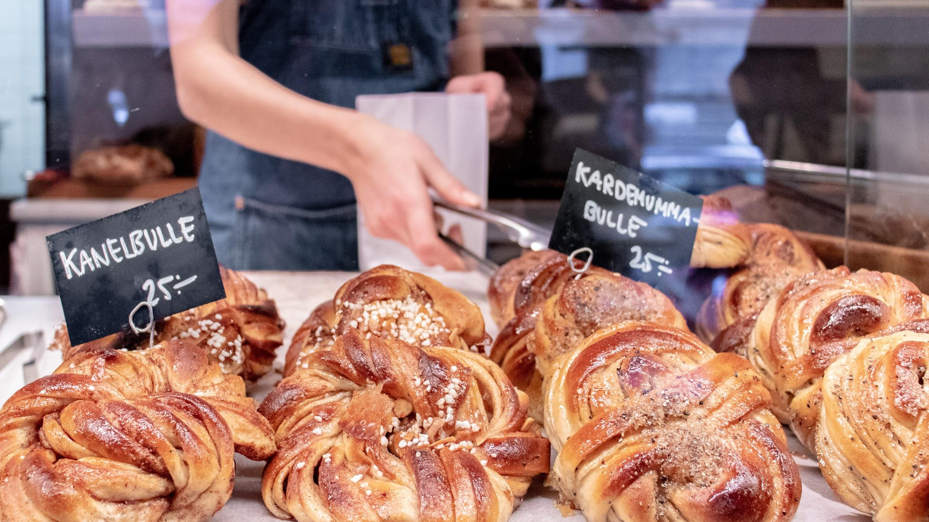
We will explain how palm oil production affects ecosystems.
CHECK FOR UNDERSTANDING
Why have palm oil plantations been established around the equator?
Soaps, detergents, baked goods and biofuels all use palm oil. Today, palm oil is used in approximately 50% of all packaged₁ goods.
Due to the high demand for oil and low production costs, palm oil plantations have been established around the equator. This has an effect on these tropical ecosystems and their unique inhabitants.
VOCABULARY
1 - mass produced items

Slide 13
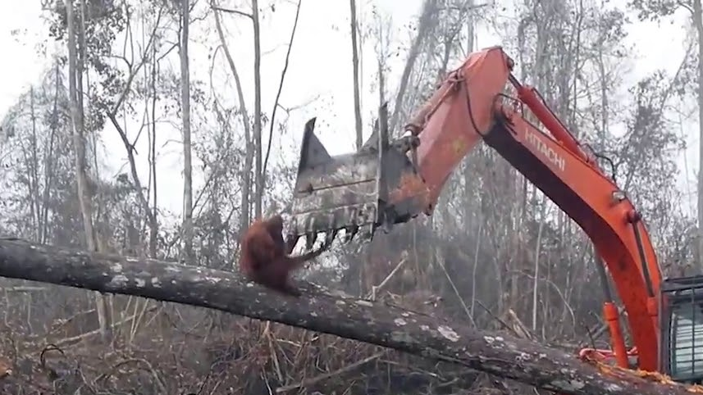
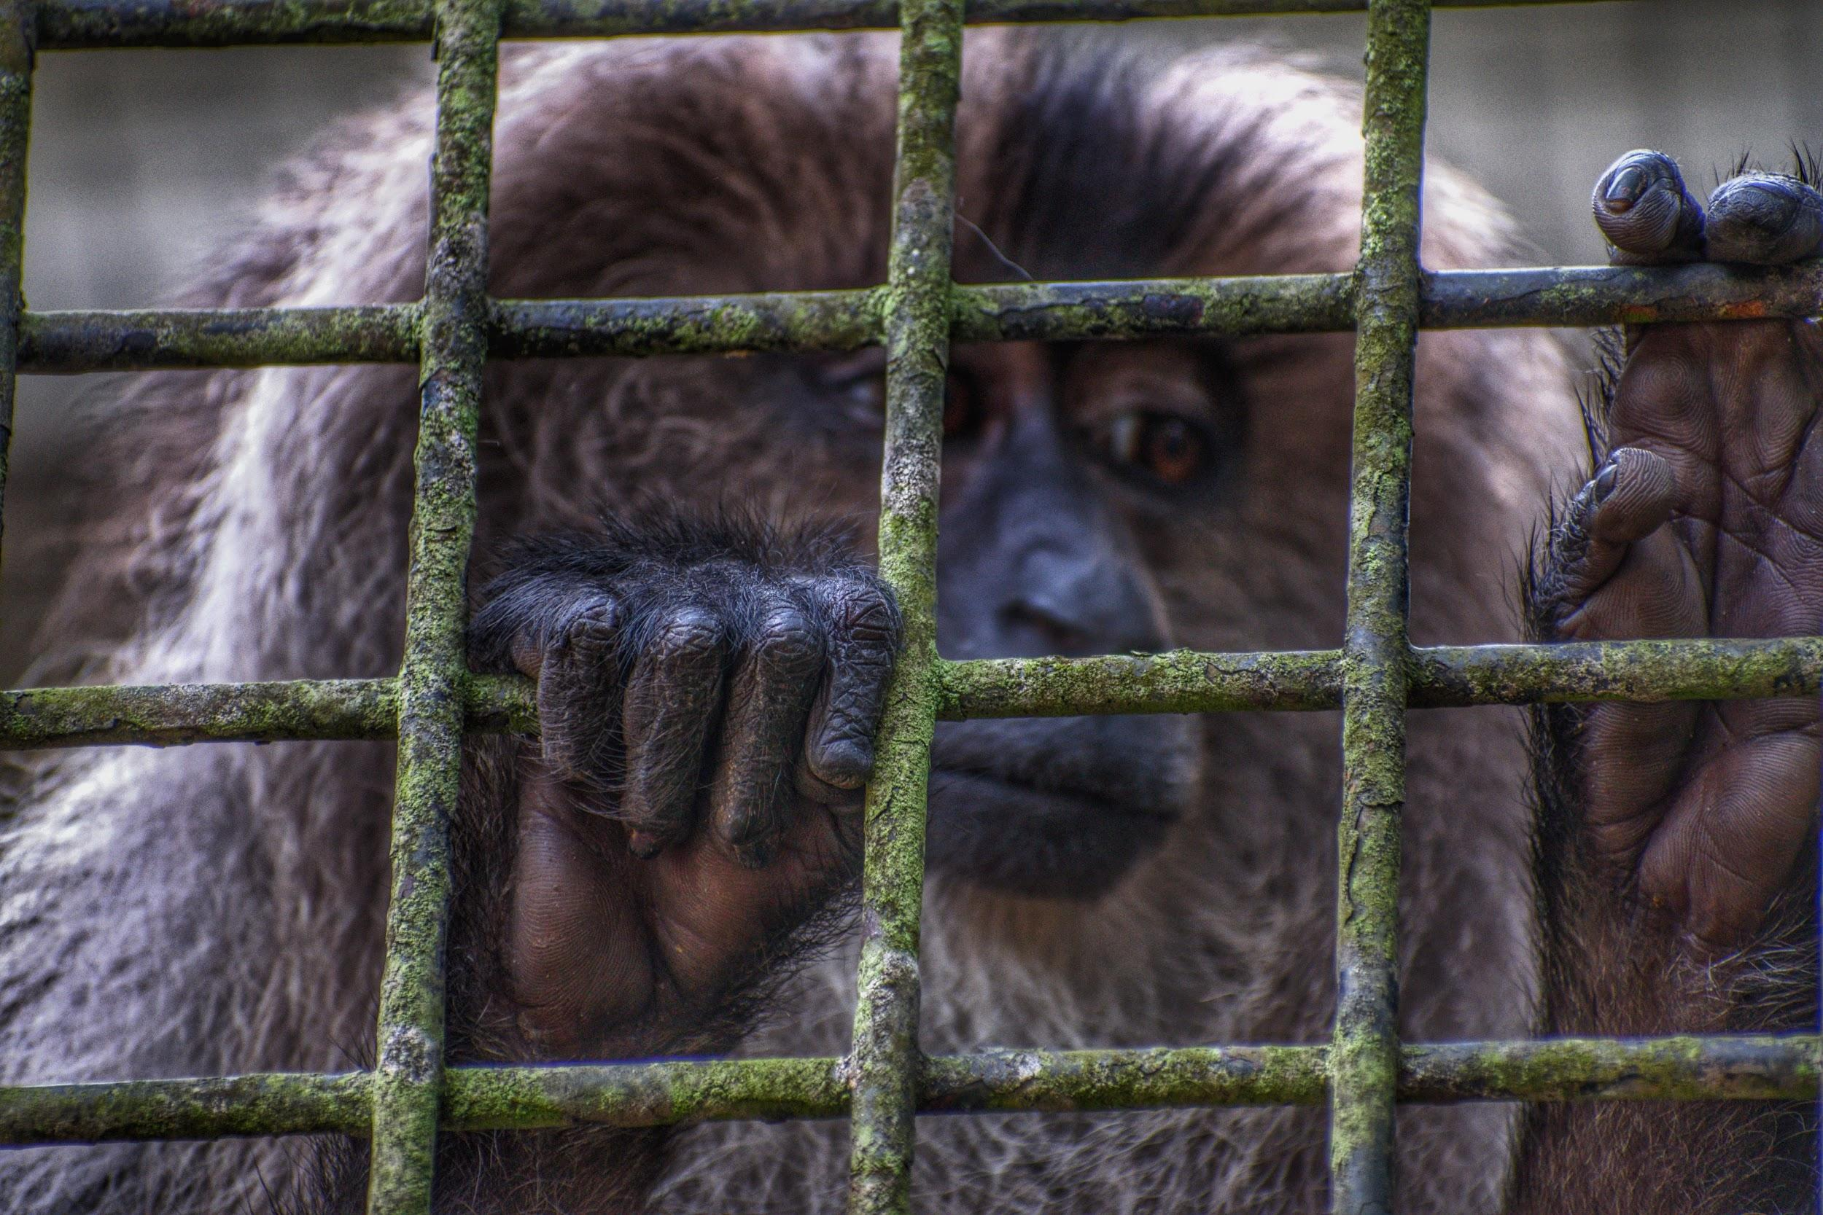
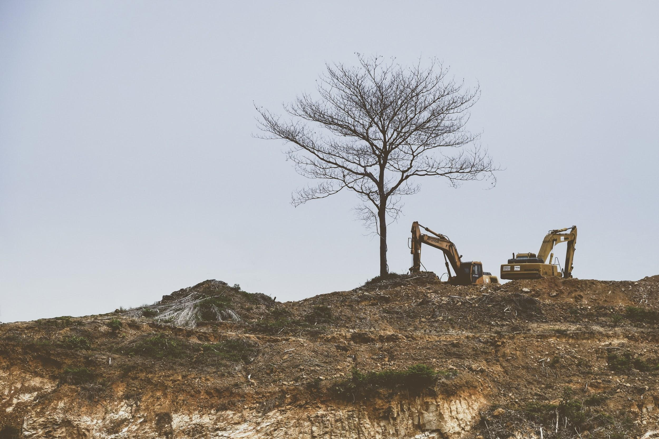
We will explain how palm oil production affects ecosystems.
CHECK FOR UNDERSTANDING
Why does deforestation threaten critically endangered species? Destroys their food sources. Destroys their habitats. Both of the above.
The World Wildlife Fund (WWF)estimates that an area of around 300 football fields are cleared every hour for palm oil plantations₁.
Deforestation has led to the destruction of these tropical habitats which are home to critically endangered₂ species such as orangutans and Sumatran tigers.
VOCABULARY
1 - large man-made farm 2 - nearly extinct

Slide 14
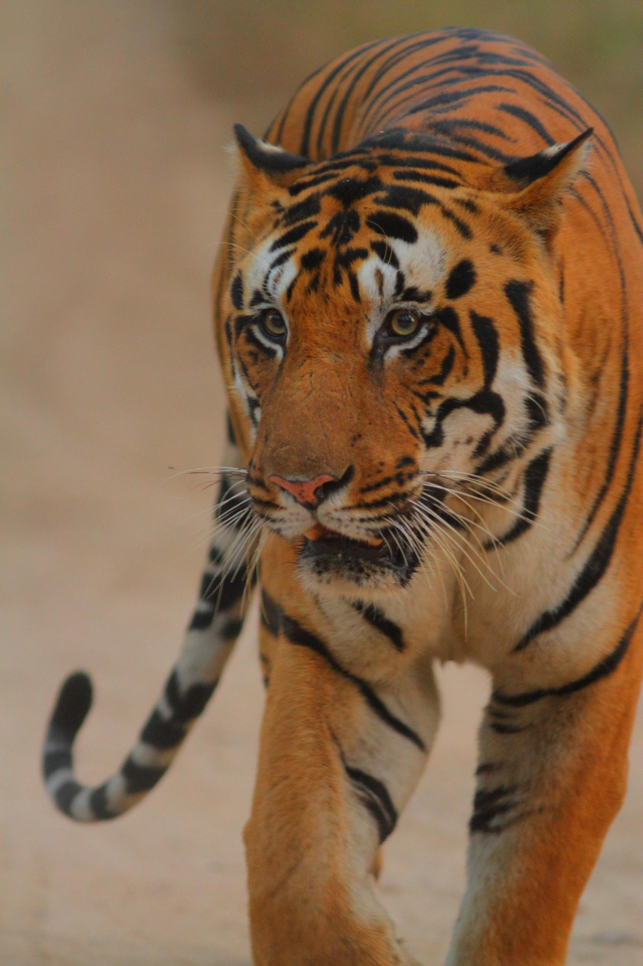
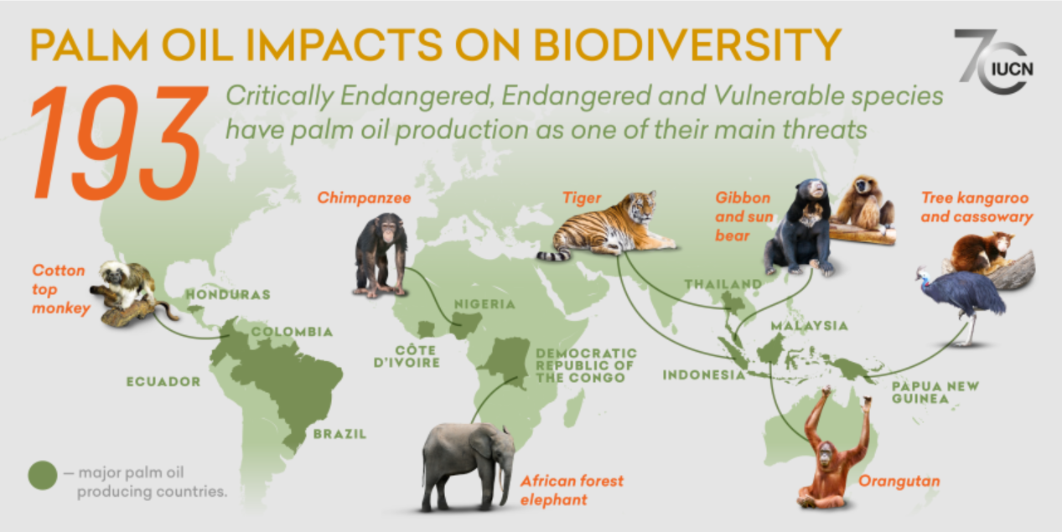
We will explain how palm oil production affects ecosystems.
CHECK FOR UNDERSTANDING
How do palm oil plantations impact the tropical ecosystems around the equator?
Orangutans live in the dense rainforests of Malaysia. Deforestation in Borneo has destroyed the tropical habitats and vegetation of orangutans. It is estimated that there are only 80,000 orangutans left.
Similarly, deforestation throughout Indonesia has threatened the critically endangered₁ Sumatran tigers.
It is expected that less than 400 Sumatran Tigers are alive today.
VOCABULARY
1 - few remaining in the wild

Slide 15
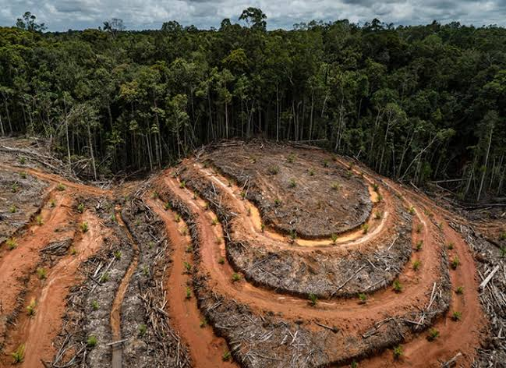
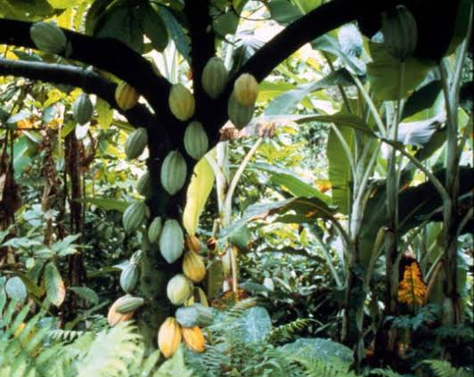
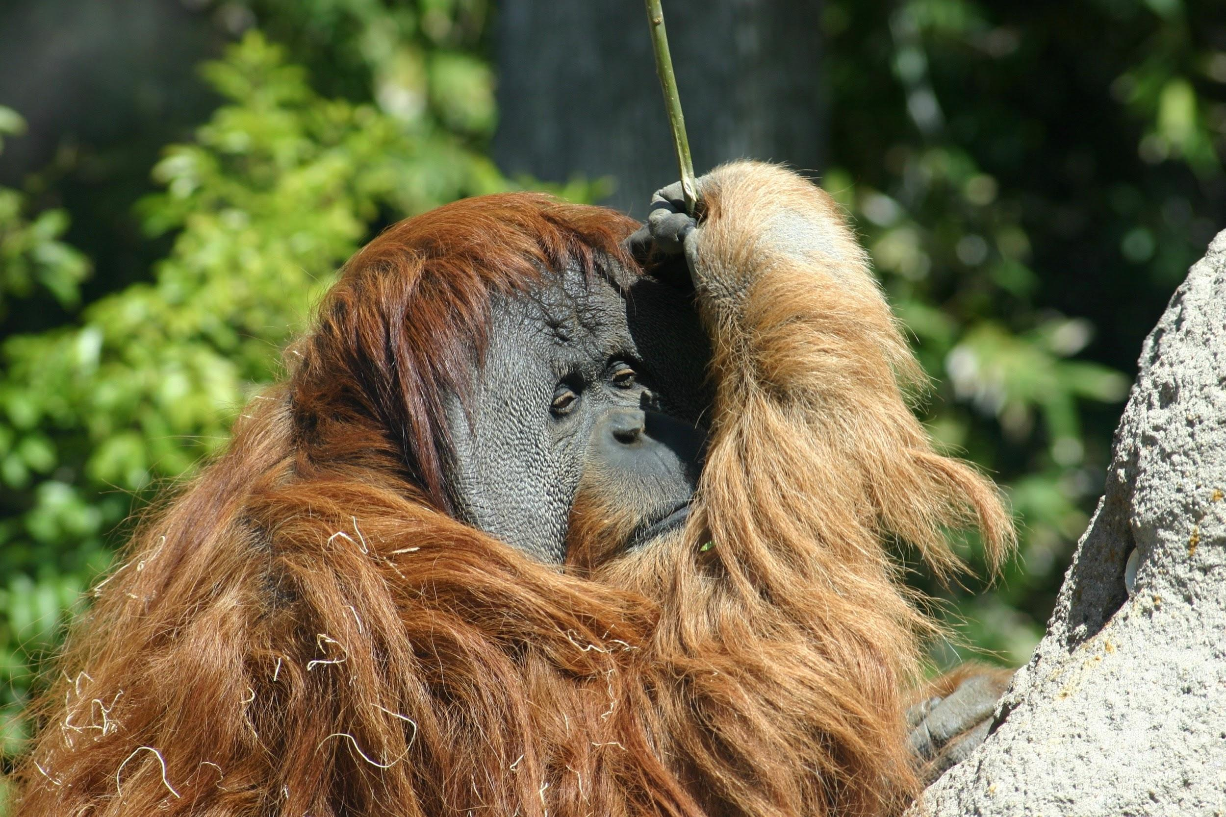
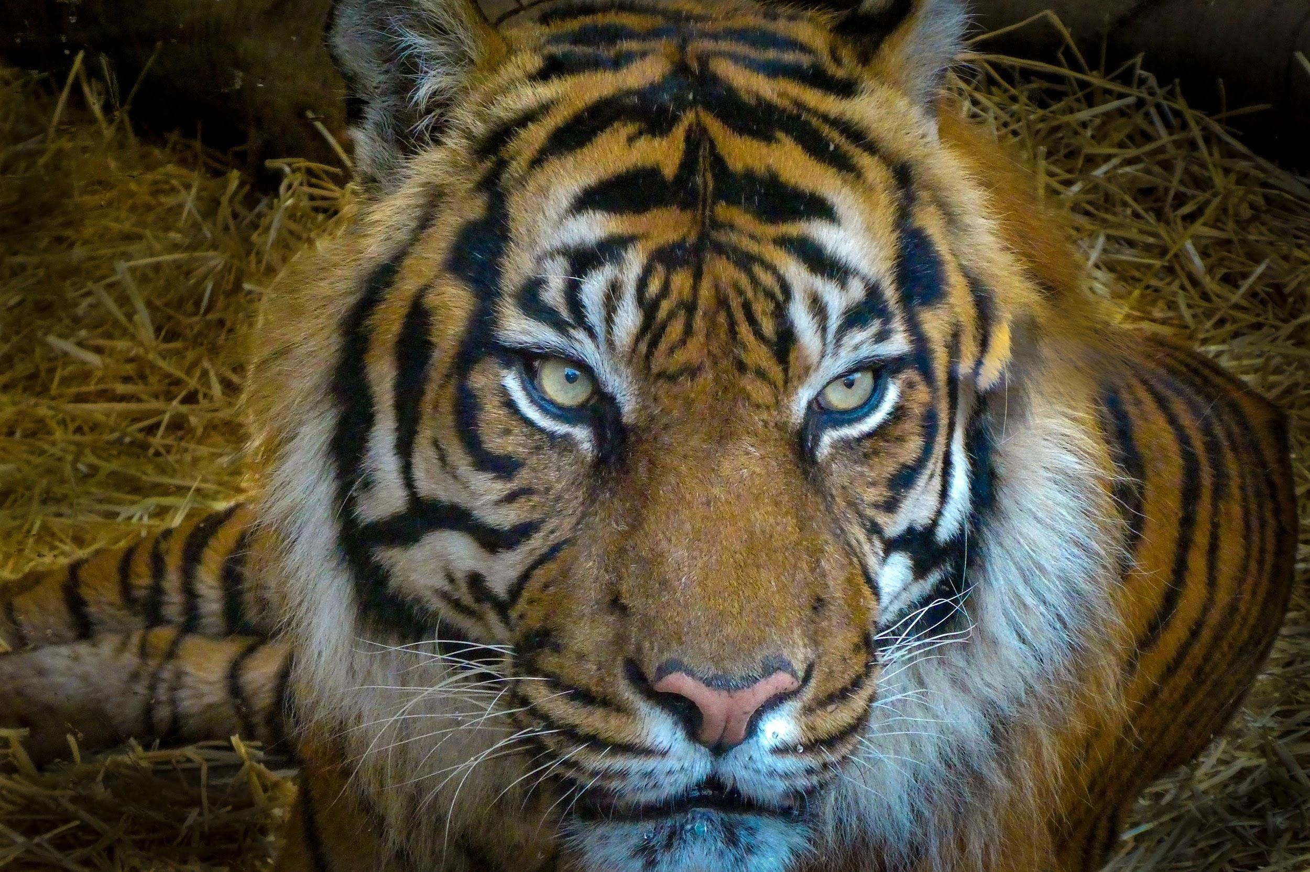
We will explain how palm oil production affects ecosystems.
CHECK FOR UNDERSTANDING
Describe some of the negative impacts on the ecosystem below due to palm oil prodiction.
Palm oil has many negative effects on the ecosystem.
Cleared land reduces the availability of primary producers at the start of the food web. Orangutans are secondary consumer. They eat mainly fruit, leaves, insects and bark.
This decline continues to the rest of the consumers higher up in the food web. The main predators of orangutans are tigers and if orangutans decline, so will they.
Cleared land affects all animals in the forest as they have no habitat to live in.

Slide 16
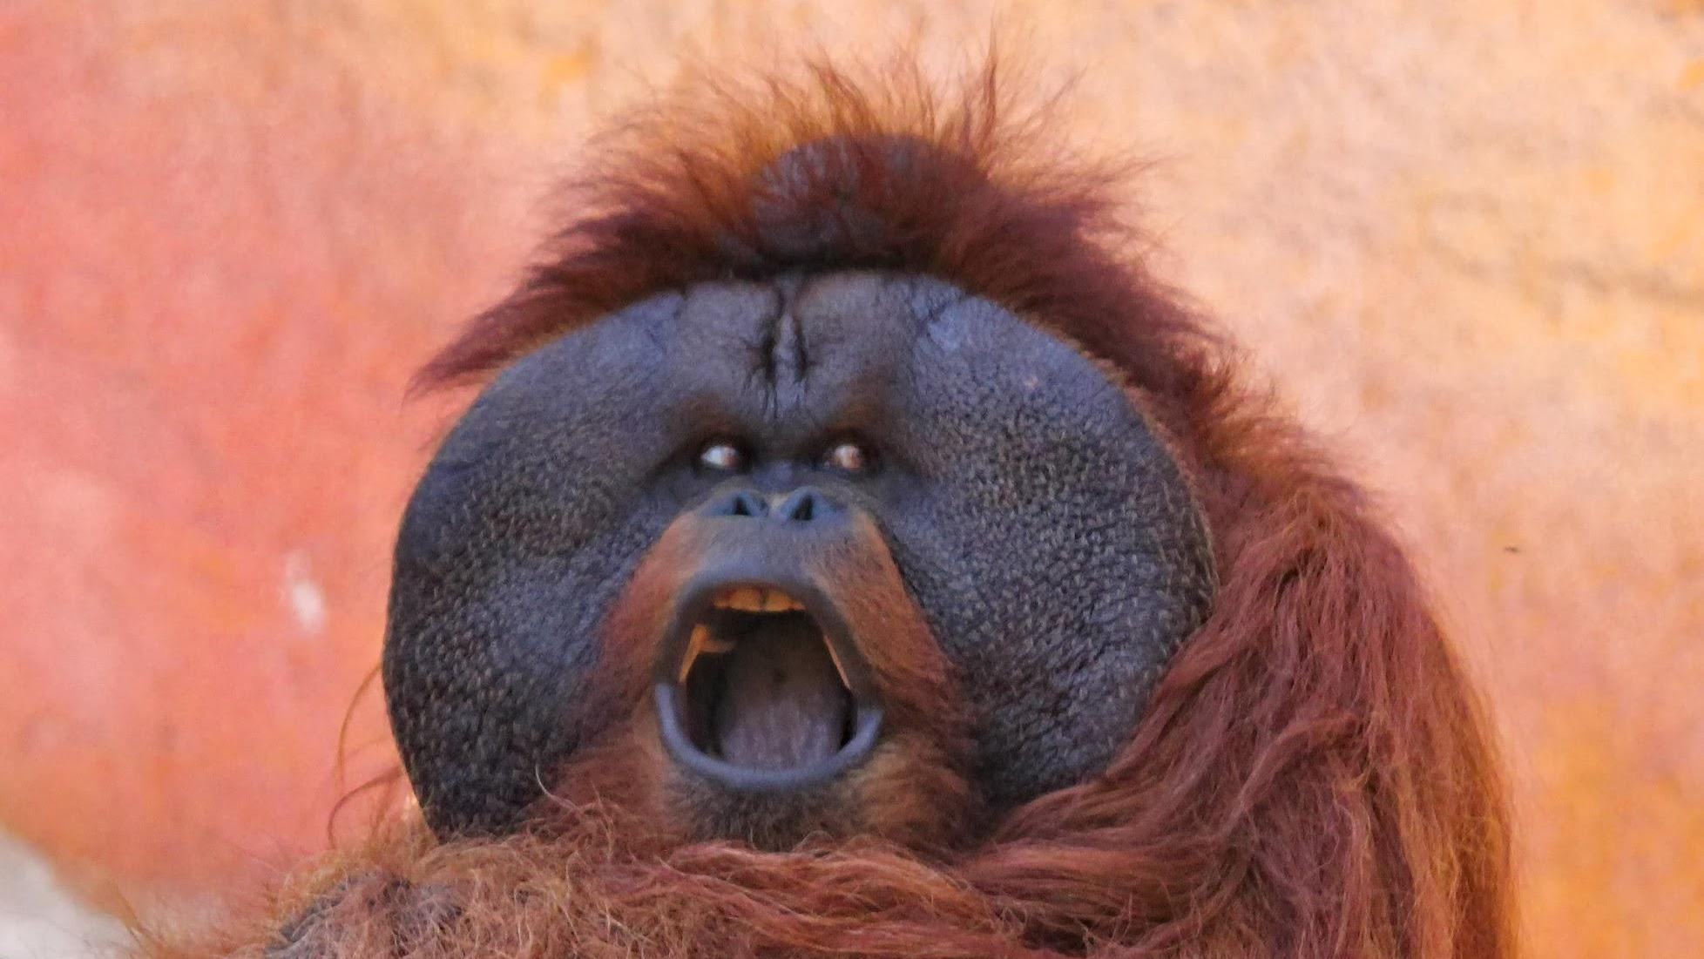
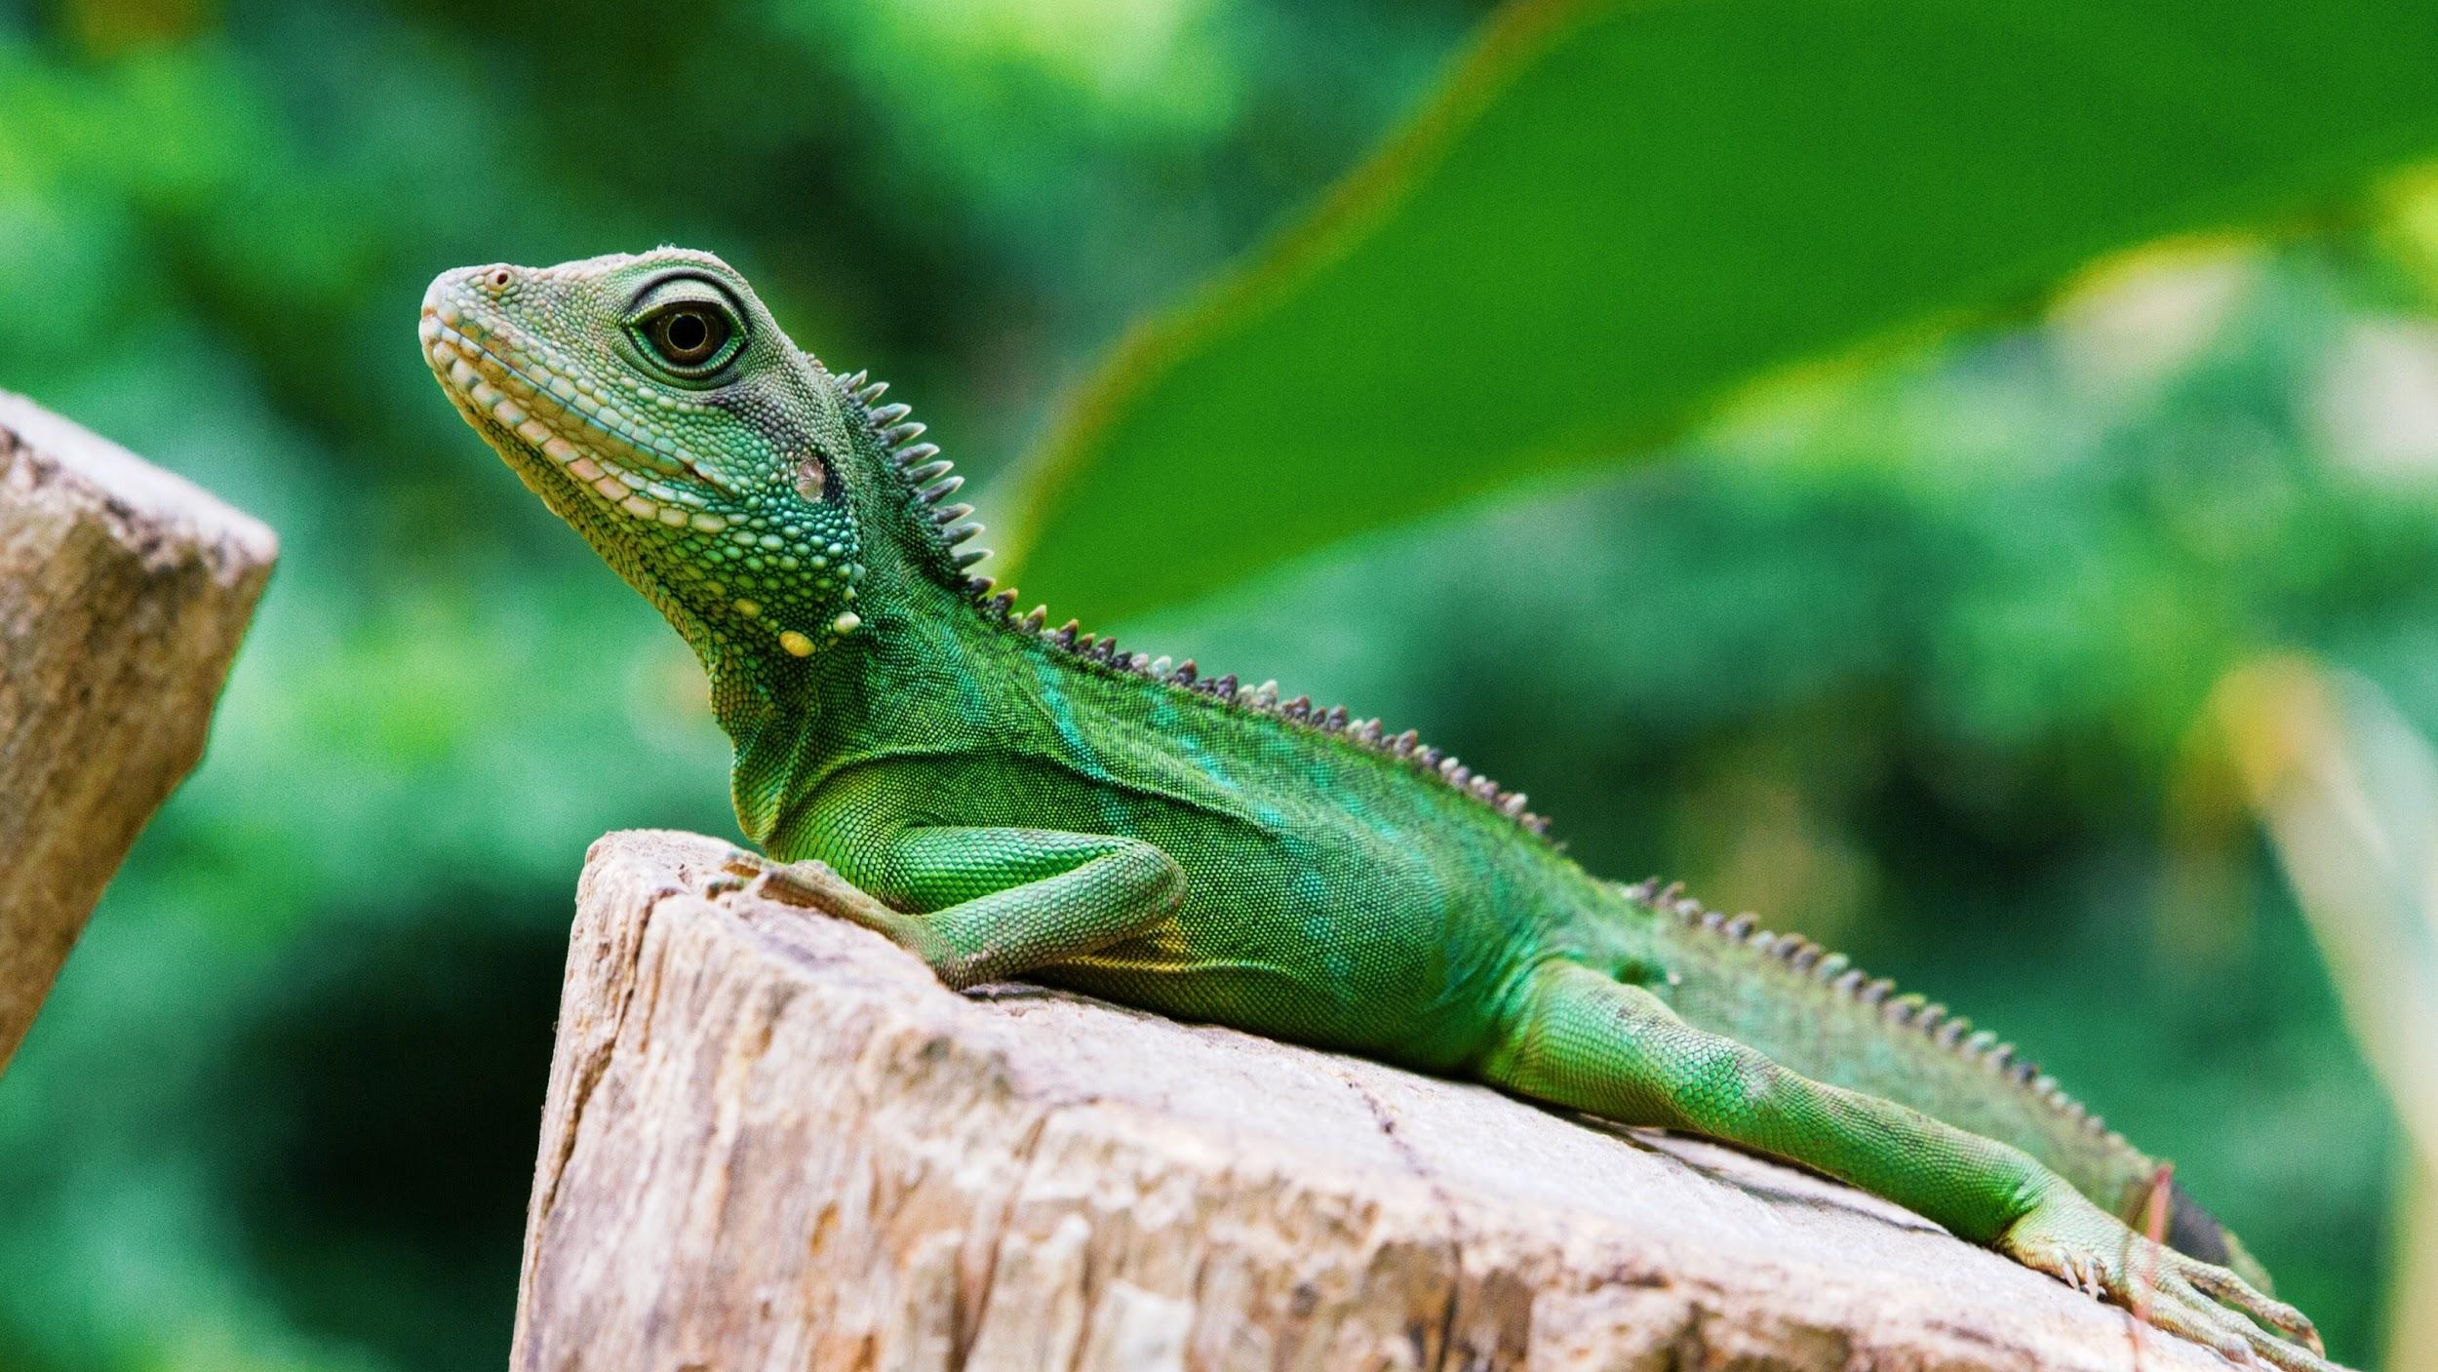
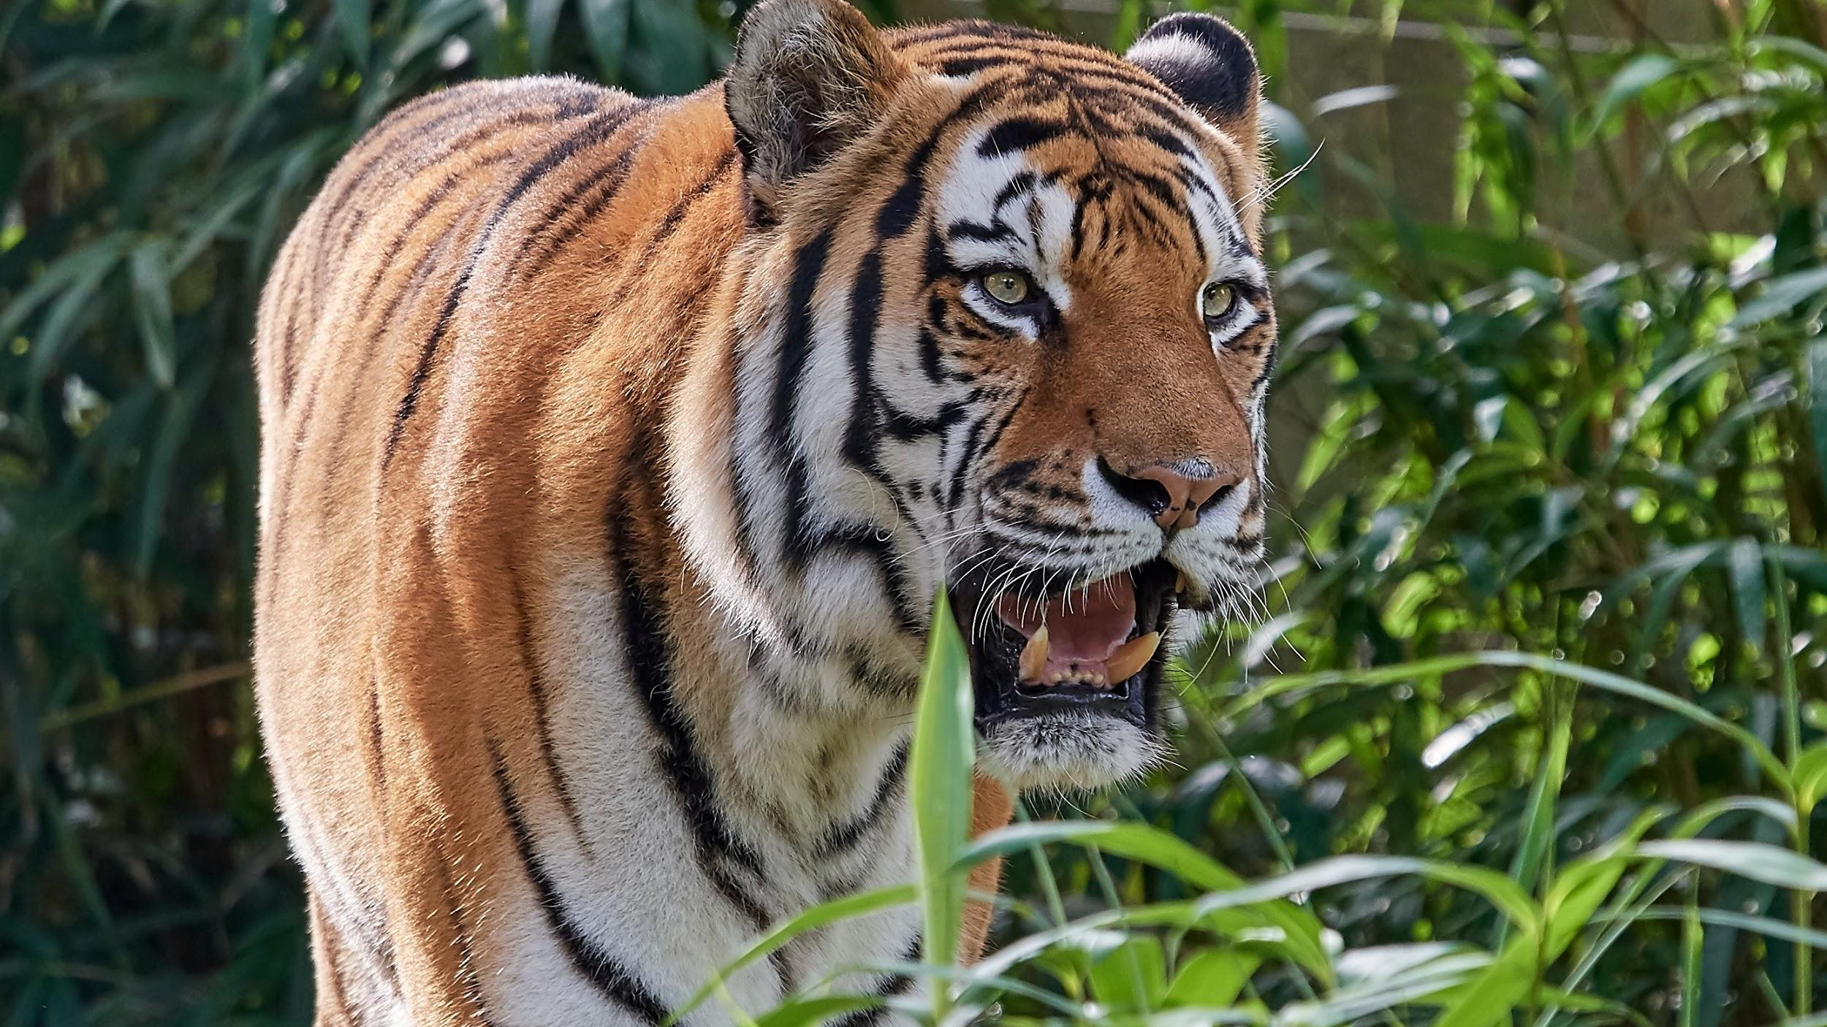
We will explain how palm oil production affects ecosystems.
Answer the following questions on your whiteboards.
HINT
Students, remember that palm oil grows in the warm tropical regions 10 degrees north and south of the equator. This region is home to the only remaining wild orangutans and Sumatran tigers. Palm oil is used in 50% of packaged products due to the low cost of production and high yield of oil. It is estimated that 300 football fields of space are cleared each hour for palm oil plantations.
Where do oil palms grow best?
What two unique₁ species live in this region?
What products are palm oil used in?
What area is cleared out each hour to make way for palm oil plantations?
VOCABULARY
1 - distinct

Slide 17
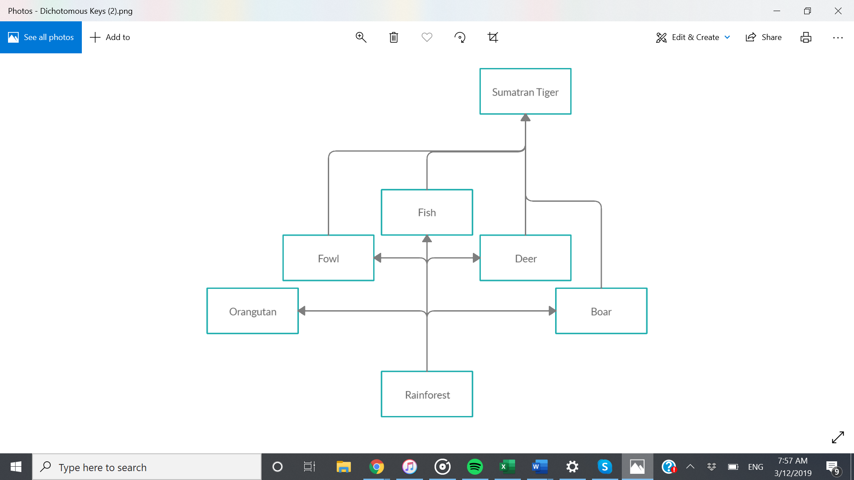
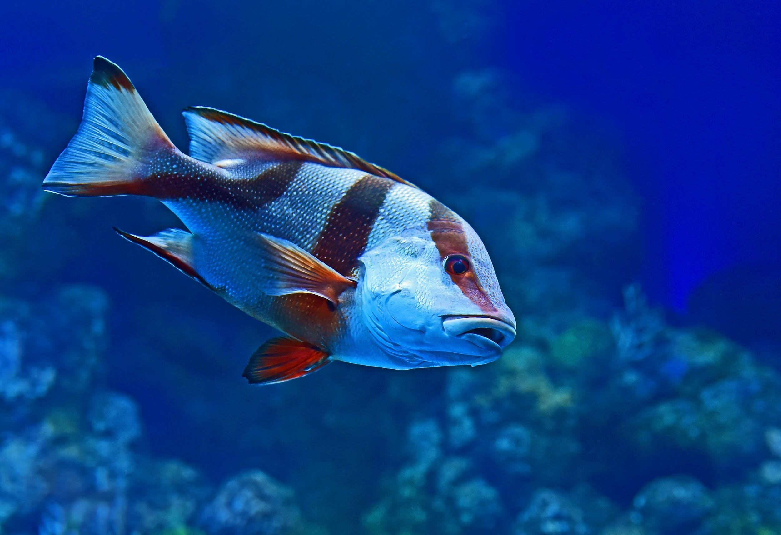
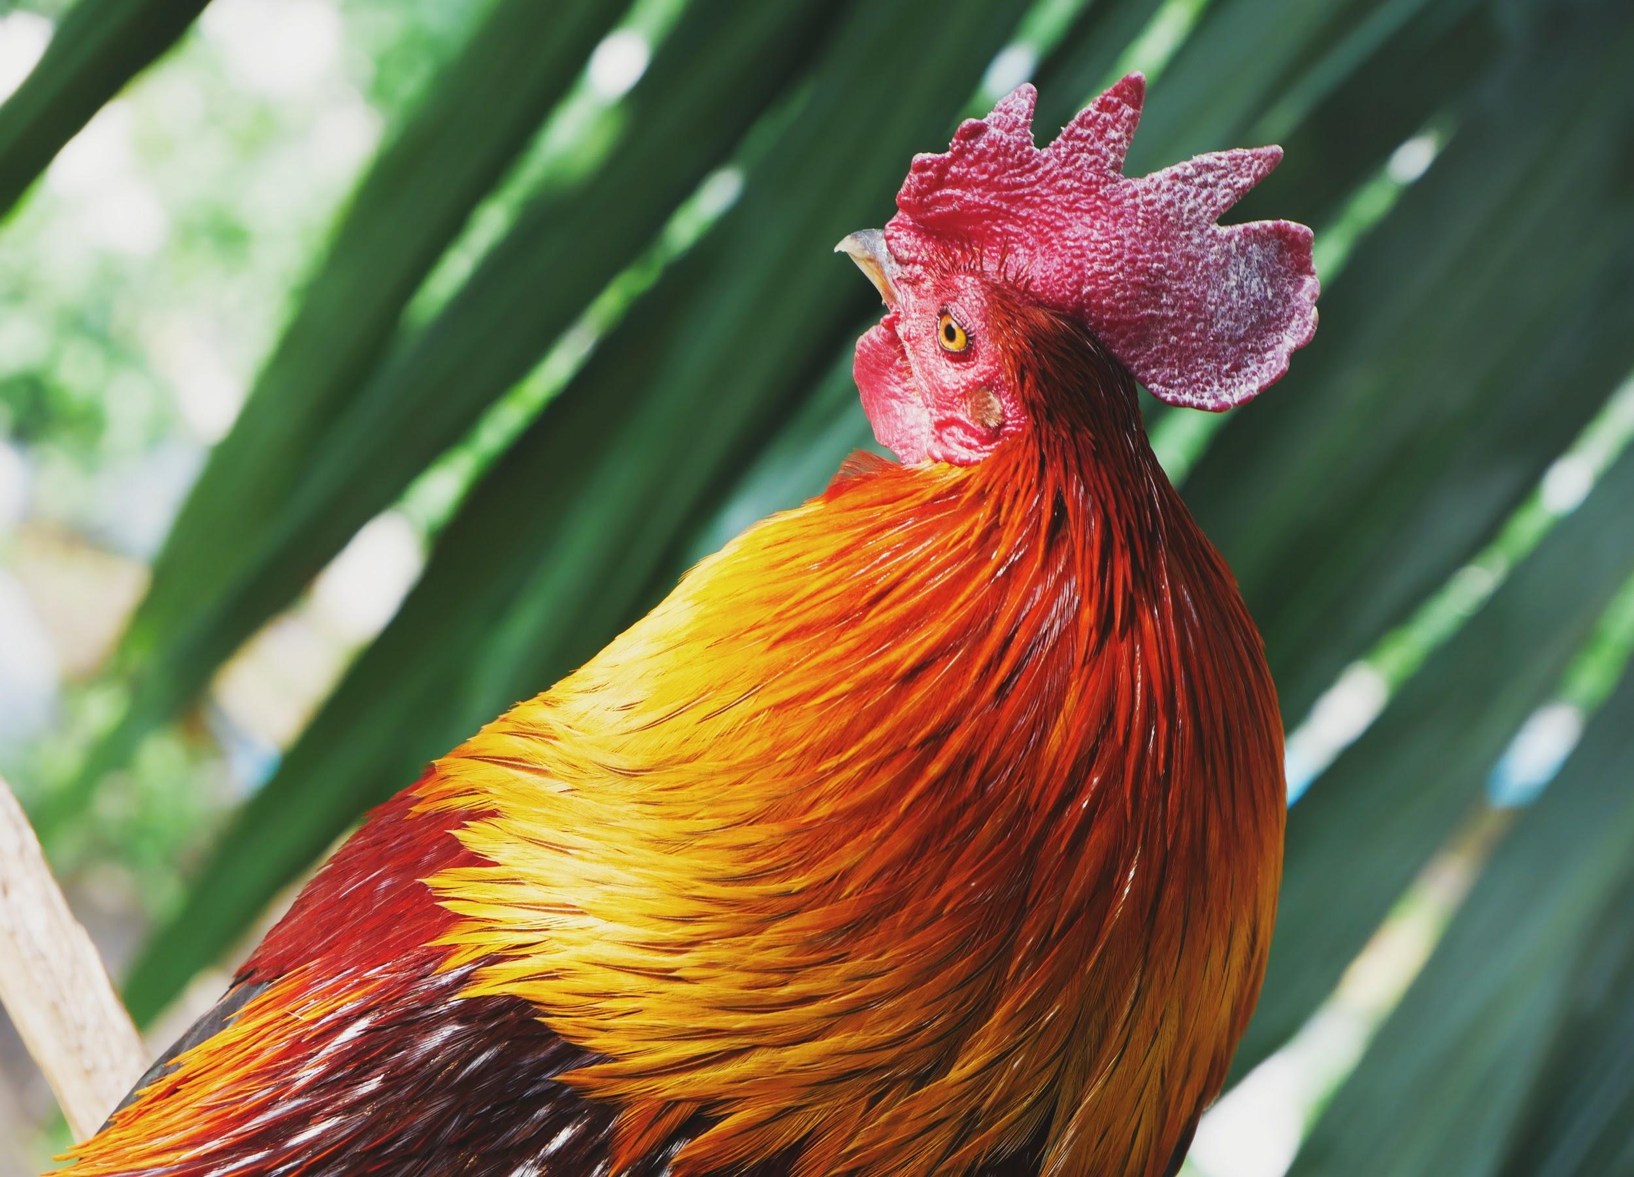
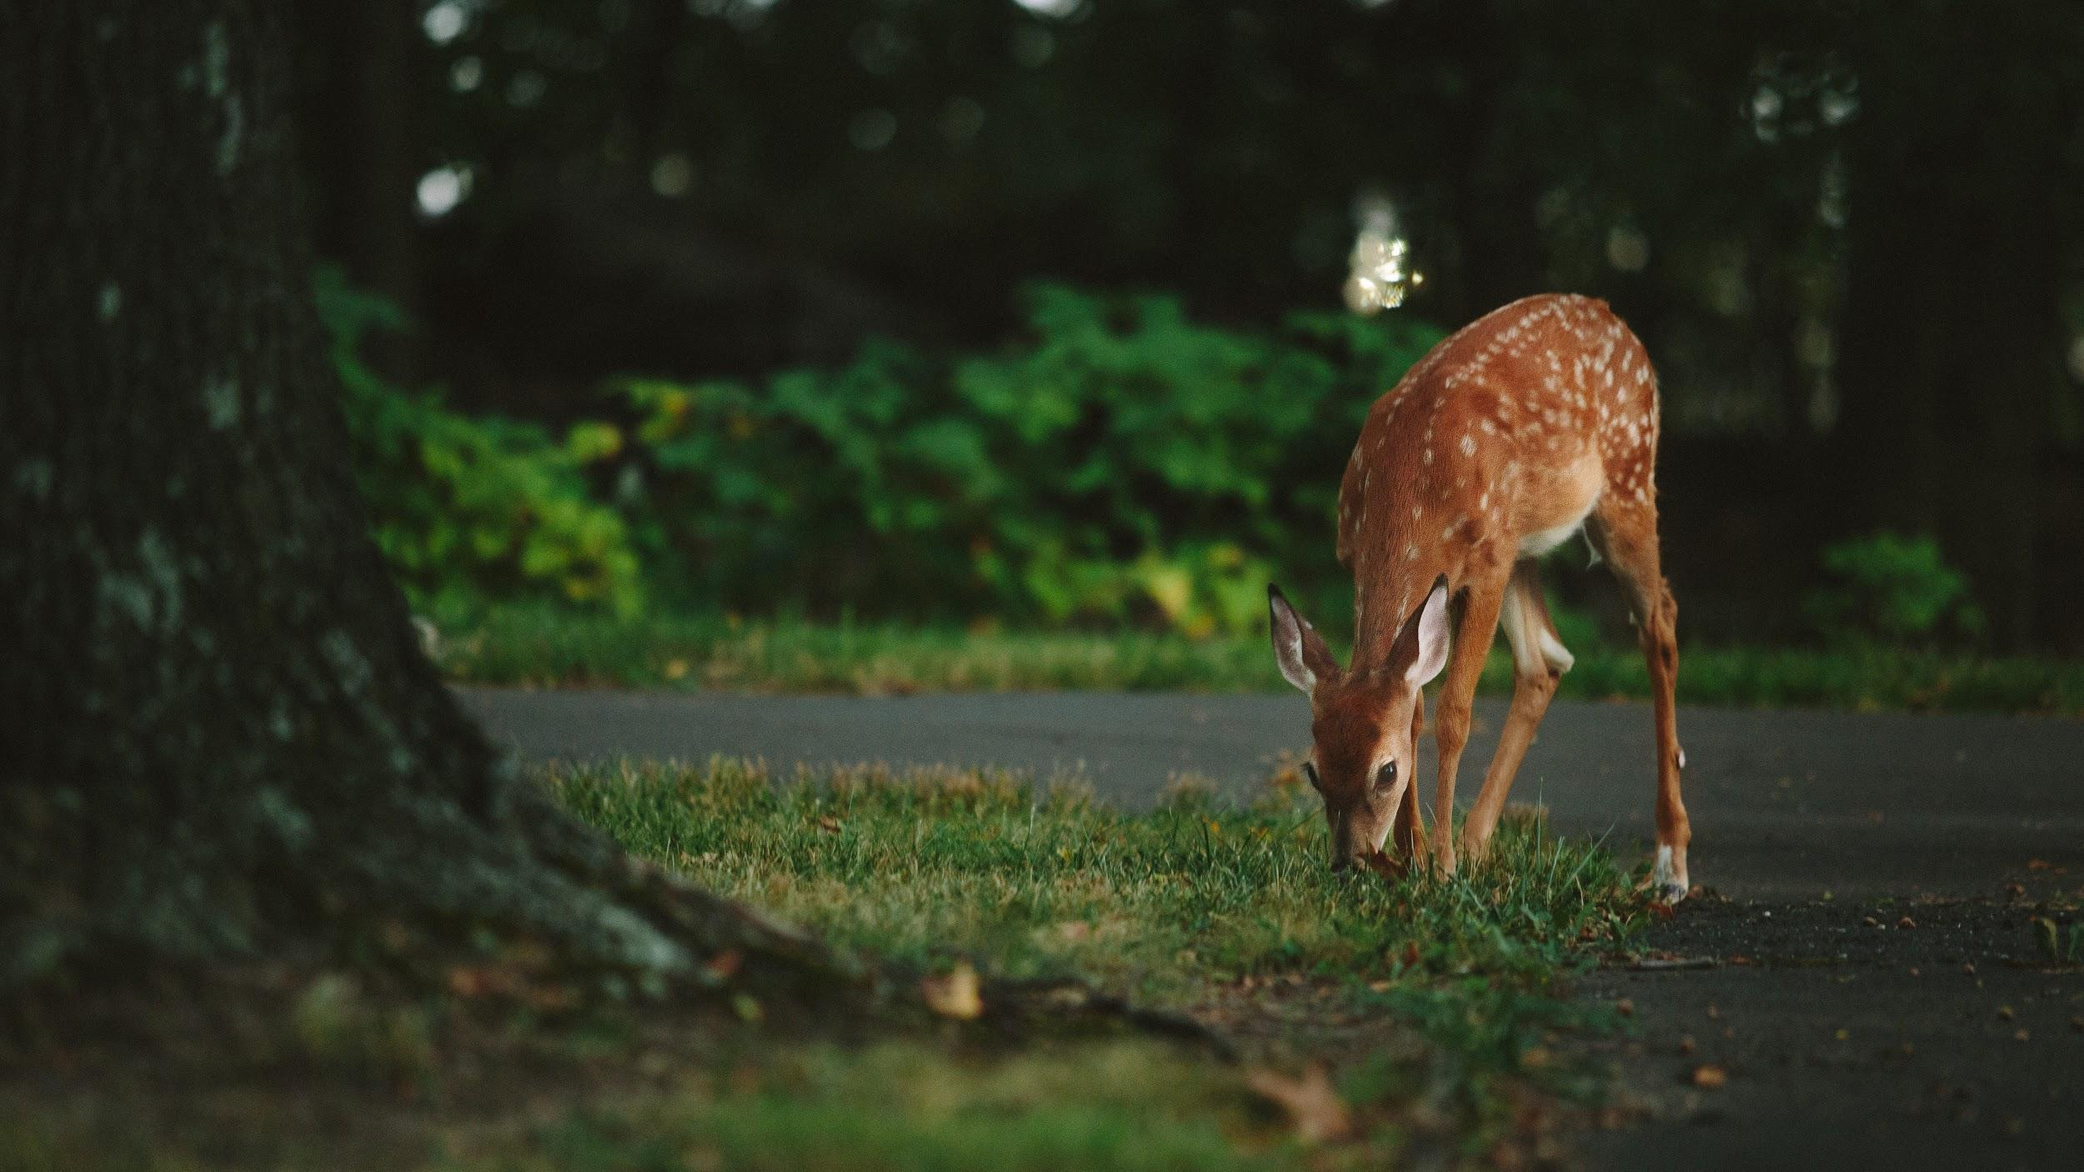
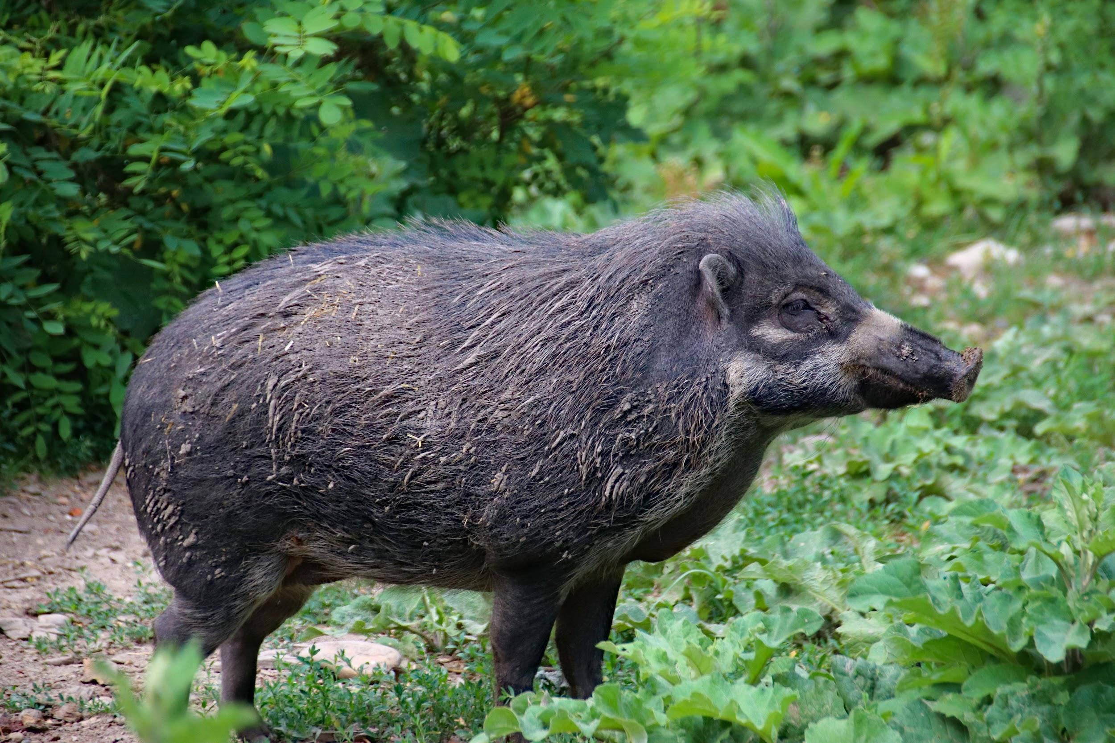
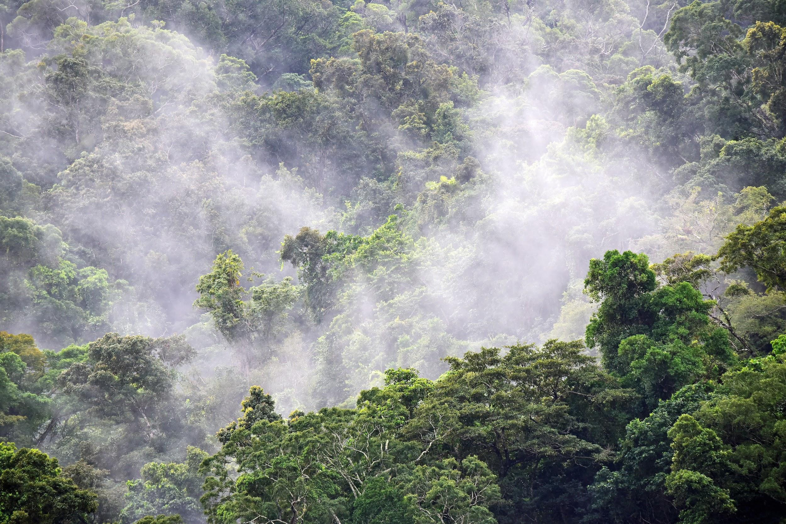
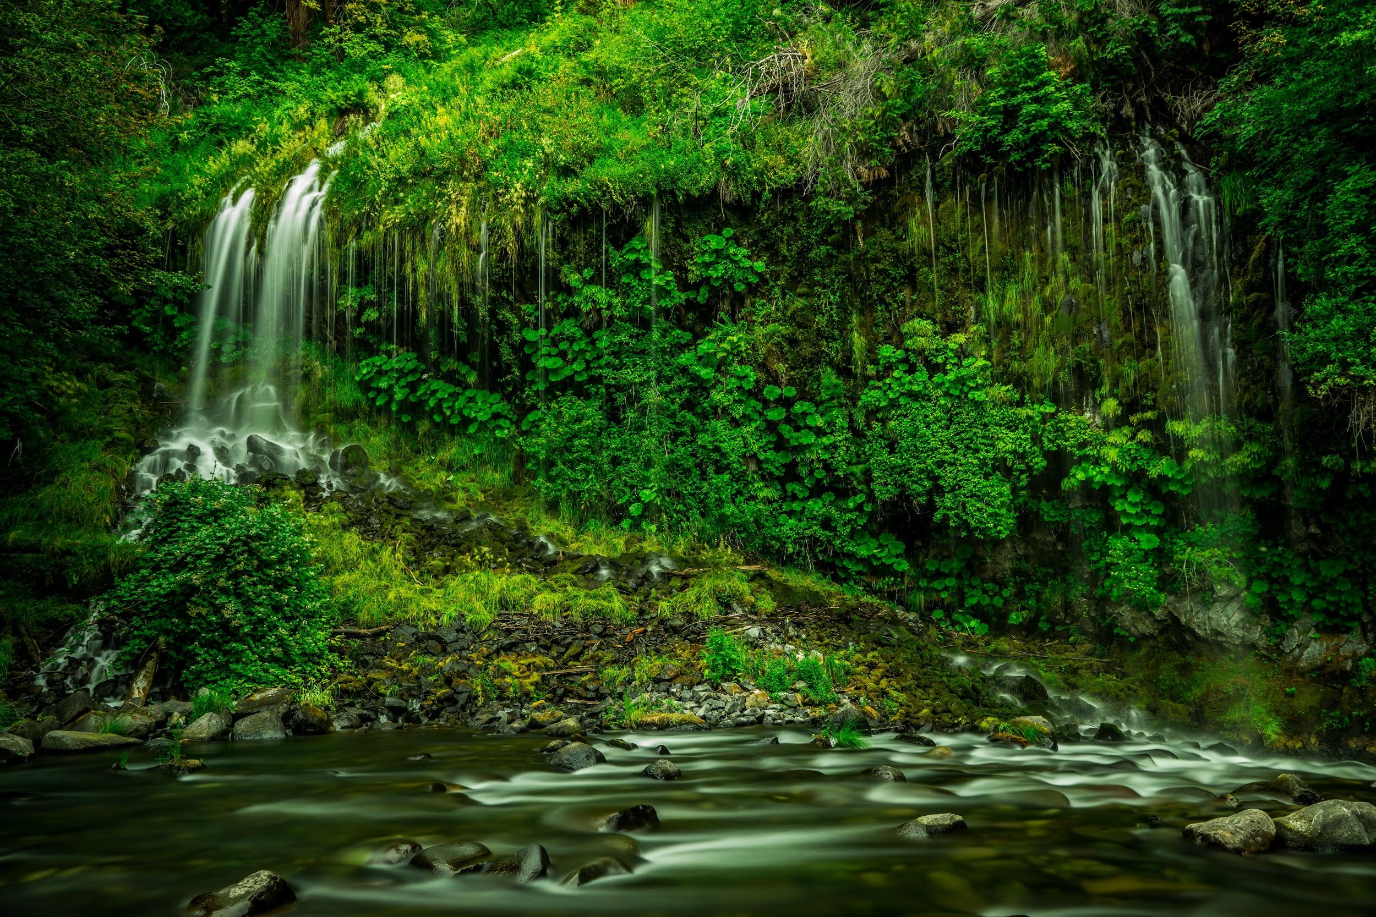
We will explain how palm oil production affects ecosystems.
Write three food chains from the food web below.
CHECK FOR UNDERSTANDING
What impact does deforestation have on the tropical ecosystem₁?
HINT
Students, remember a food chain shows which organisms eat other organisms.
VOCABULARY
1 - natural habitats

Slide 18
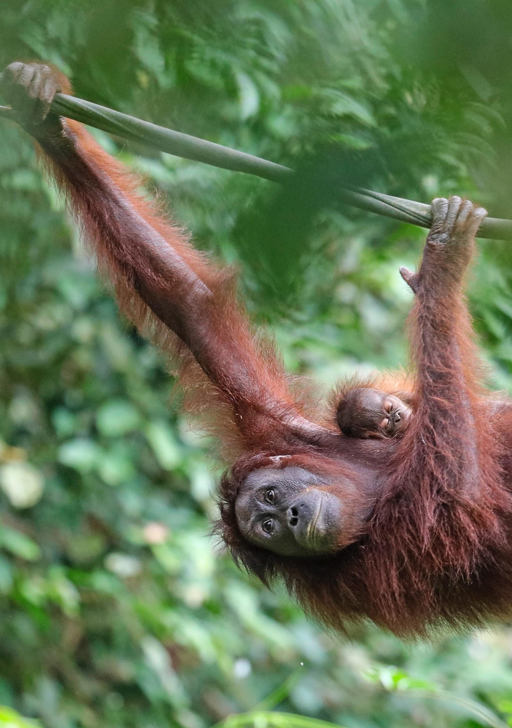
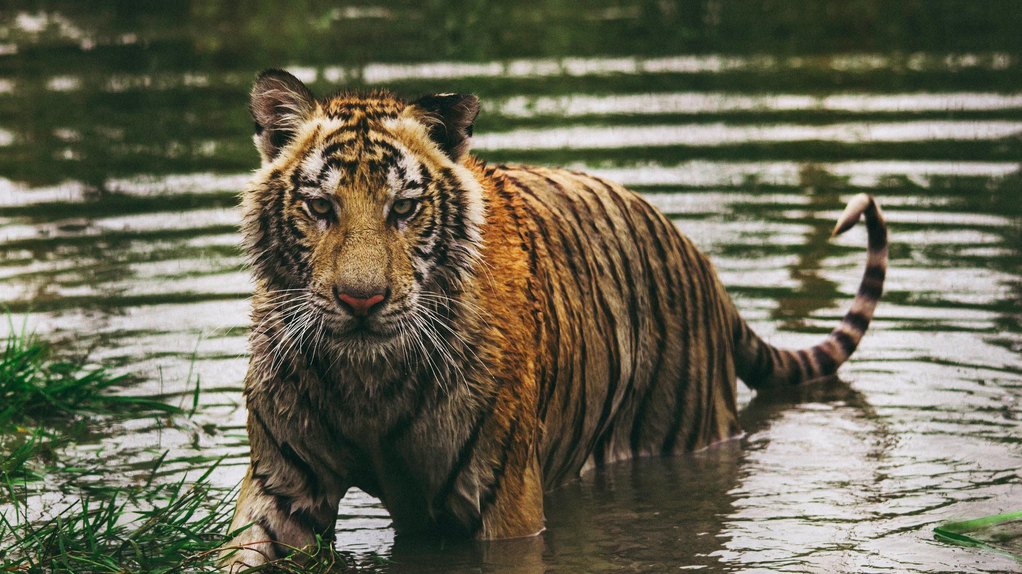
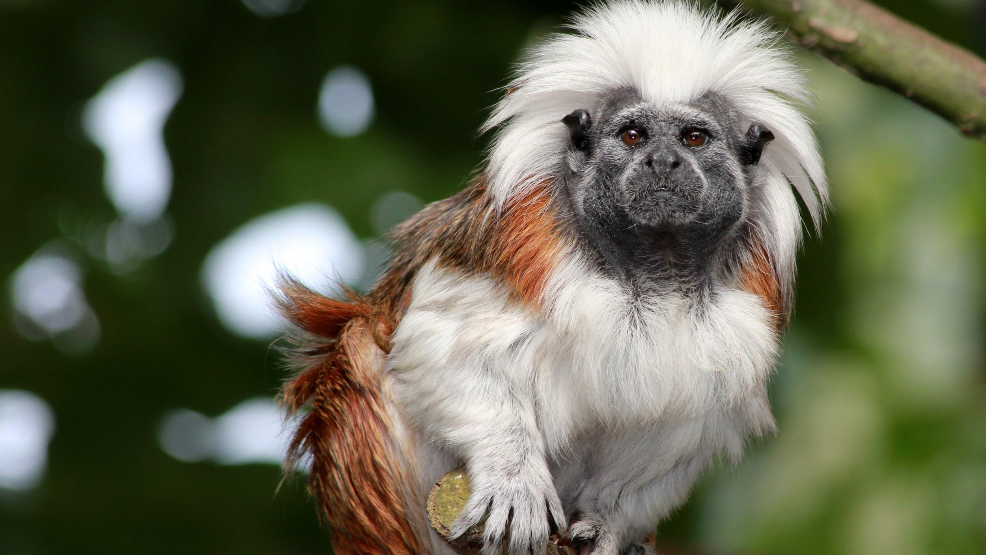
We will explain how palm oil production affects ecosystems.
CHECK FOR UNDERSTANDING
Why are palm oil plantations only present around the equator?
Organisations and activists are campaigning for sustainable palm oil plantations to conserve and protect the natural habitats₁ of orangutans, tigers and hundreds of other species.
The tropical lands around the equator are the only places where these creatures will survive in the wild, however deforestation due to palm oil plantations are threatening their survival.
VOCABULARY
1 - animals ecosystem

Slide 19

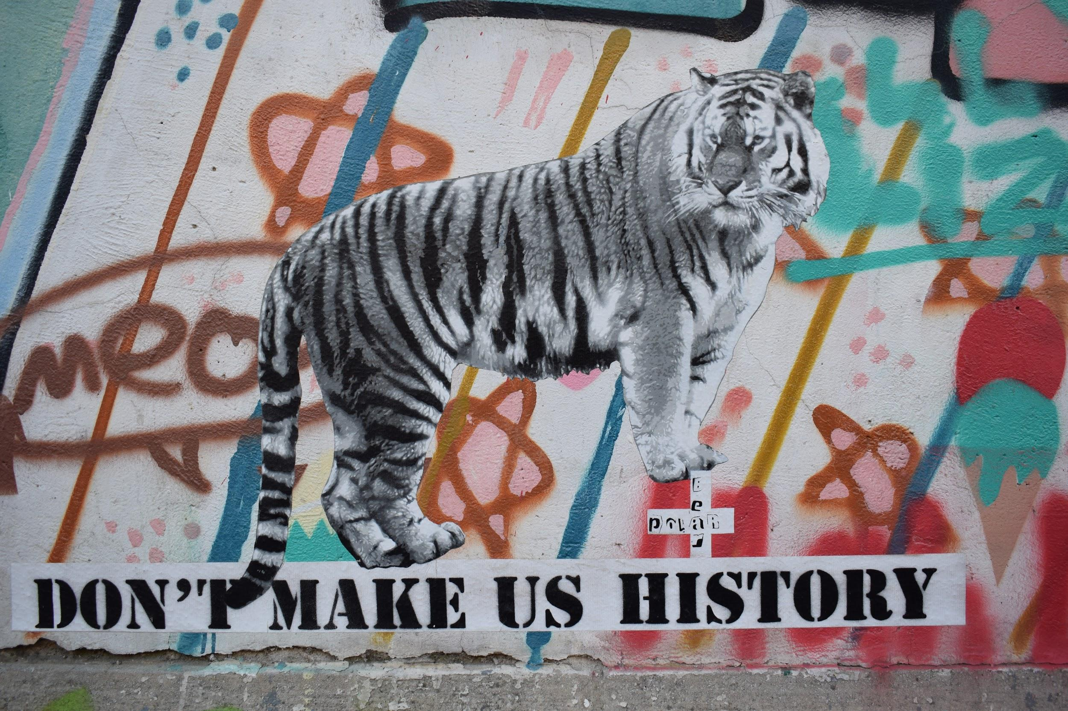
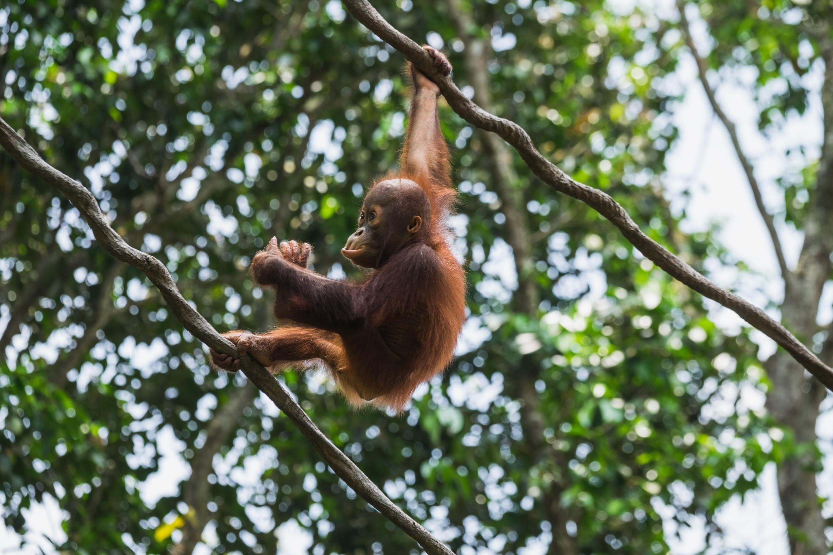
We will explain how palm oil production affects ecosystems.
CHECK FOR UNDERSTANDING
Why is palm oil only grown around the equator?
Palm oil plantations are a low cost, high yield₁ method of producing oils for cooking, cleaning and packaged good. However, palm oil will only grow in tropical regions around the equator.
This threatens many critically endangered species that only survive in these tropical conditions.
VOCABULARY
1 - produces a lot of oil

Slide 20
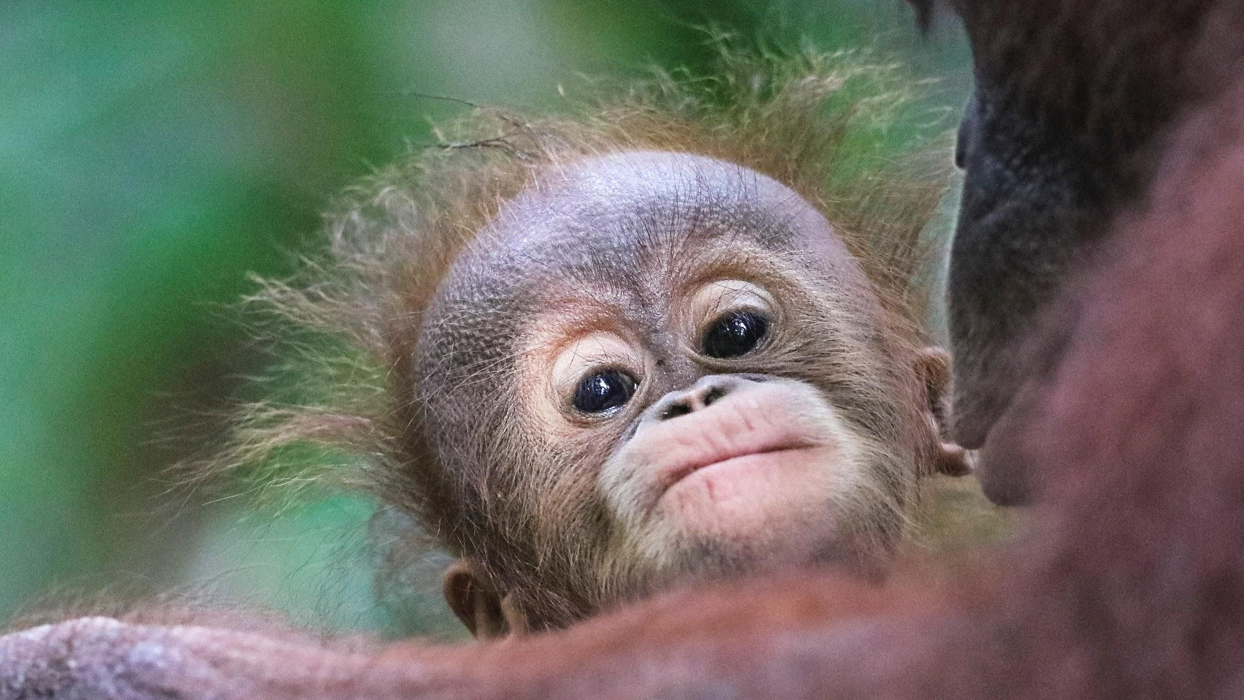
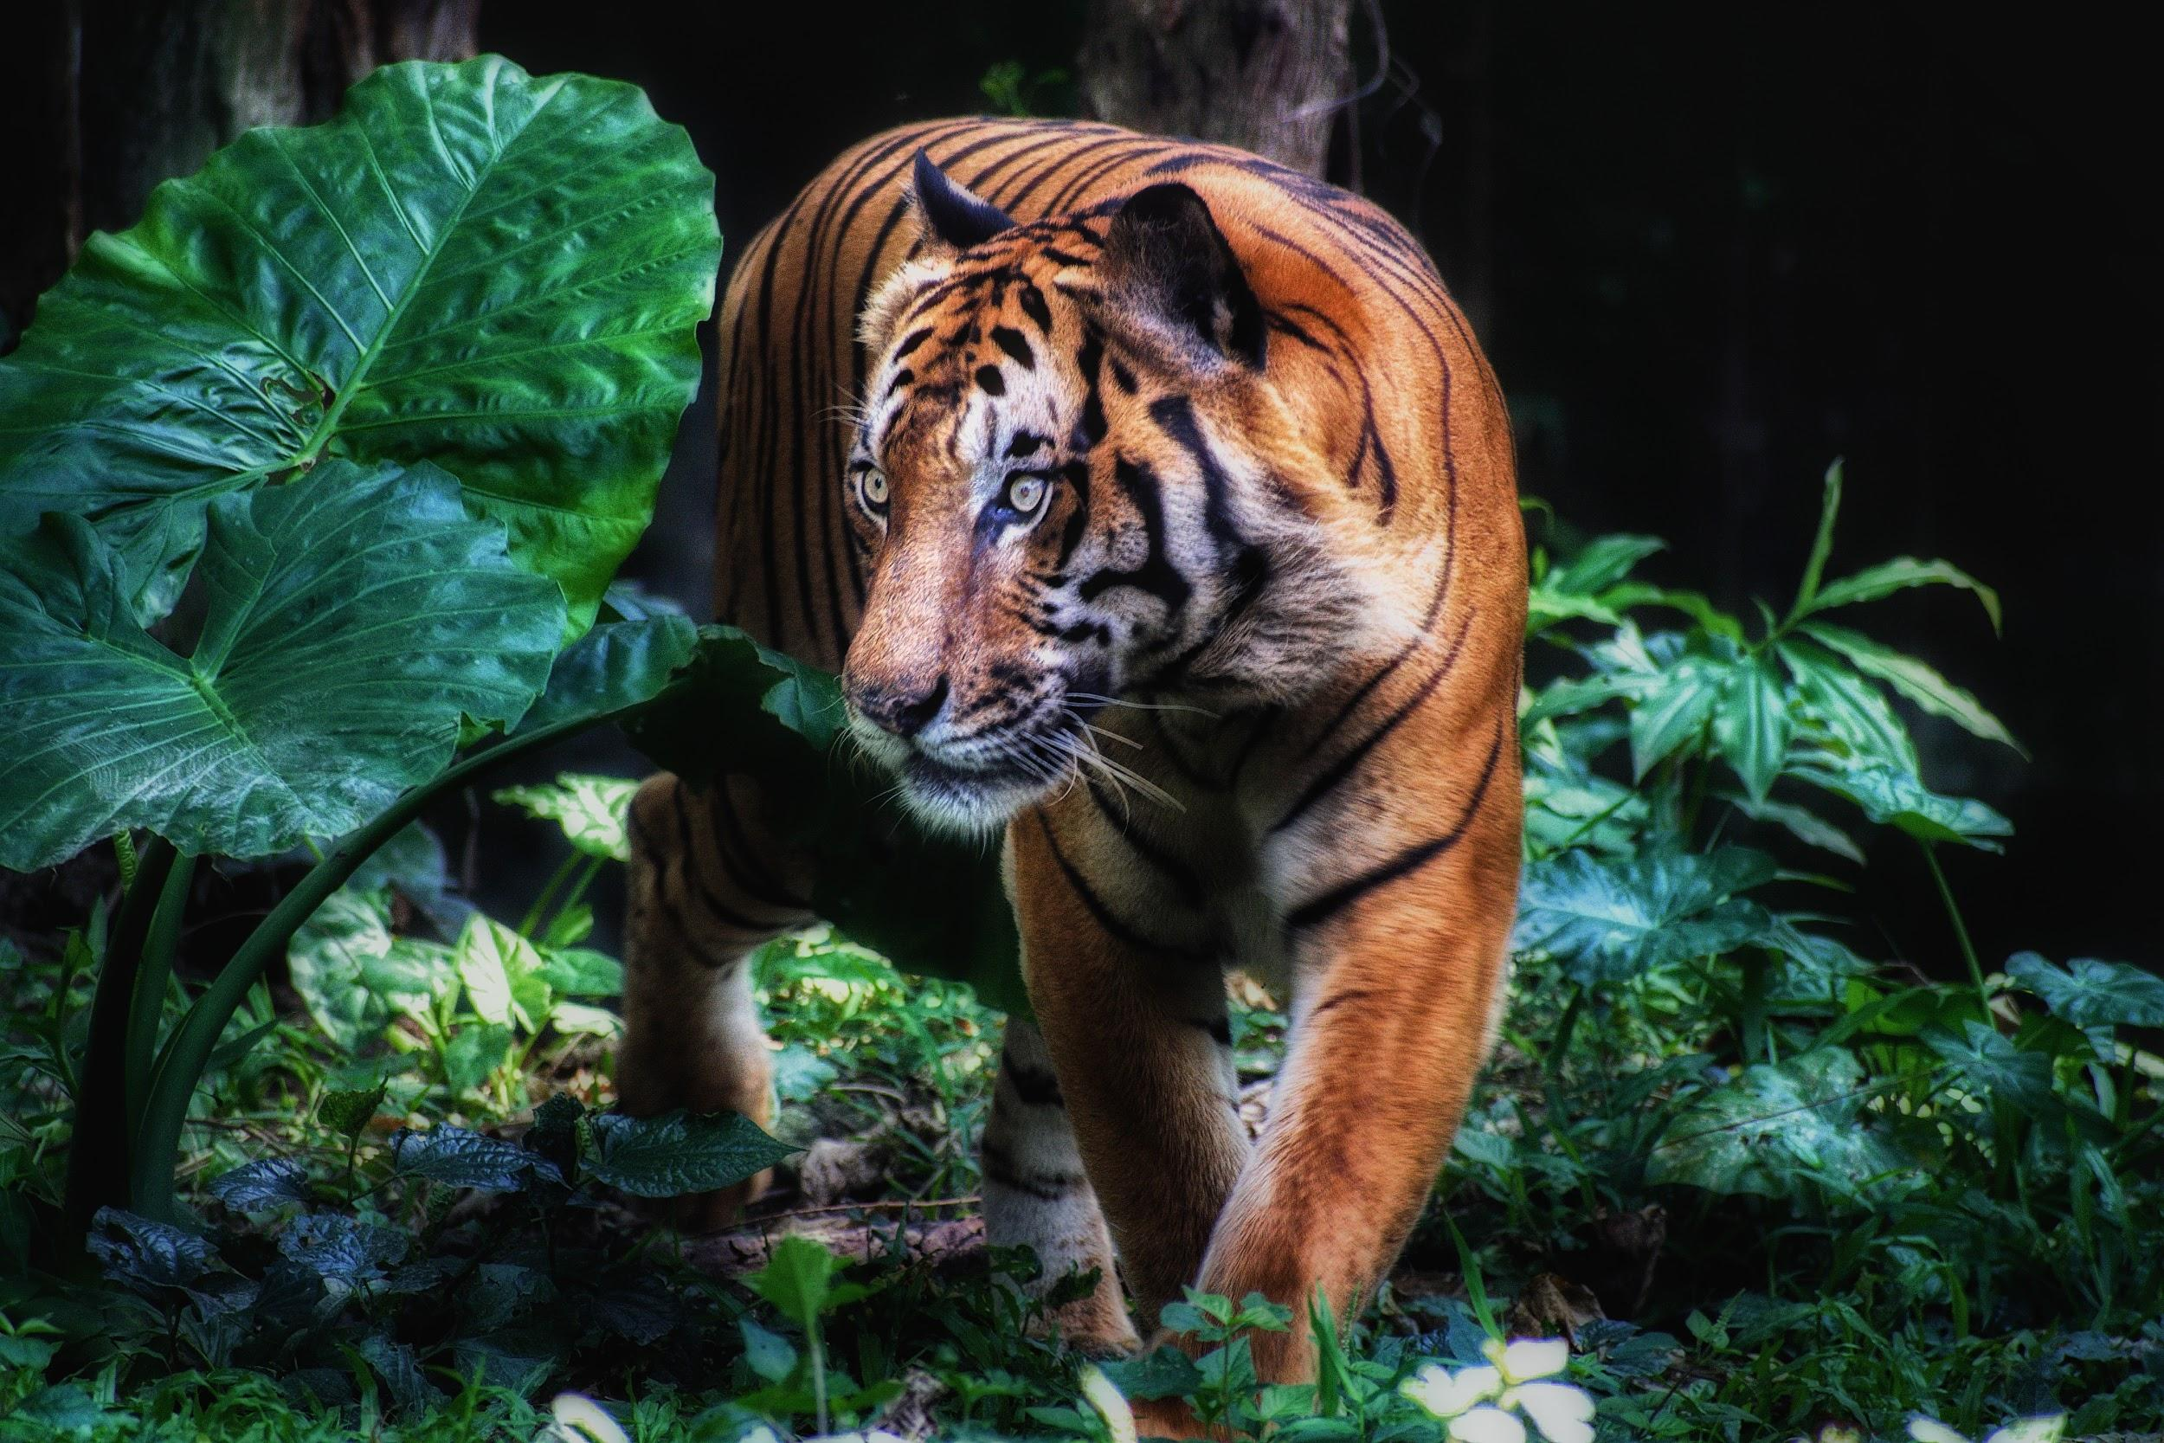
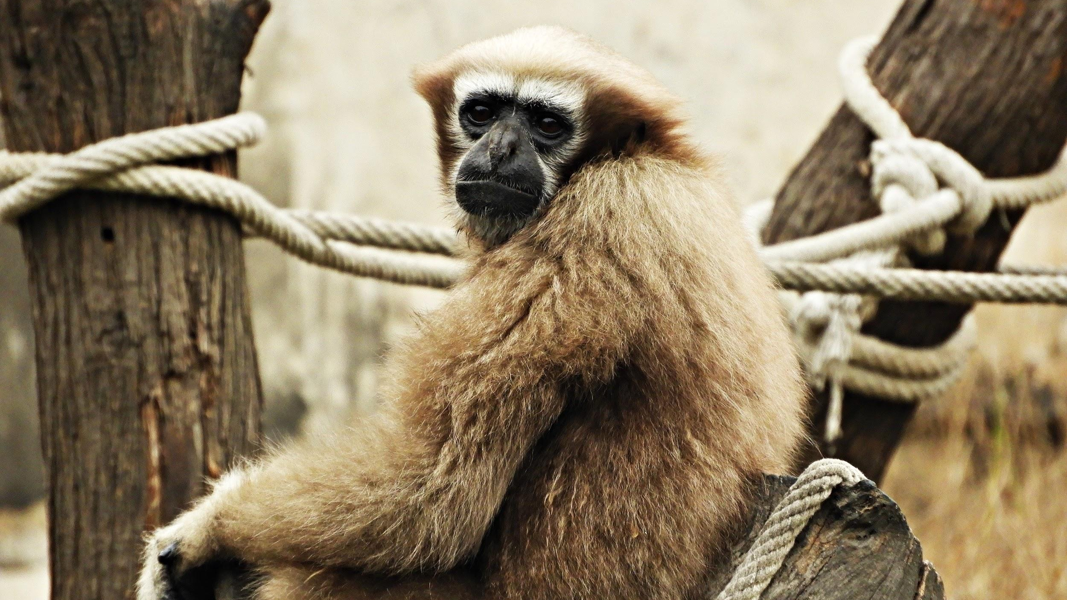
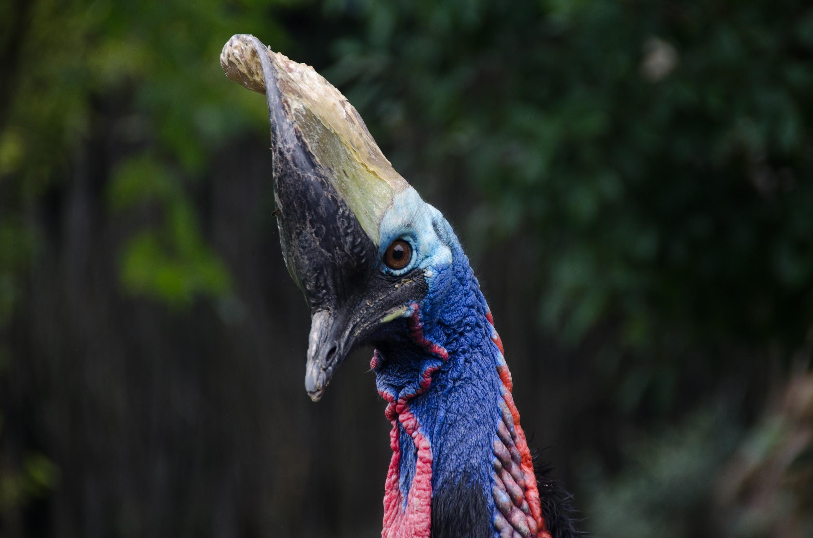
We will explain how palm oil production affects ecosystems.
EXTENSION
Research the Linnaean classification of orangutans and Sumatran tigers.
Answer the following questions in your workbooks.
HINT
Students, remember that palm oil grows in the warm tropical regions 10 degrees north and south of the equator. This region is home to the only remaining wild orangutans and Sumatran tigers. Palm oil is used in 50% of packaged products due to the low cost of production and high yield of oil. It is estimated that 300 football fields of space are cleared each hour for palm oil plantations.
Why does deforestation impact tropical ecosystems?
What can be done to protect and conserve these areas and organisms.
Create a food web that shows the relationship between orangutans, fish, fowl, deer, boar, Sumatran tigers and the rainforest.
Notes:
Please include tasks/questions here rather than just referring to a worksheet. This will save on photocopying and facilitate sharing with other schools.
Try and build tasks/questions which escalate through Bloom’s Taxonomy. This will help with differentiation.

Slide 21
We will explain how palm oil production affects ecosystems.
We will identify the impacts of palm oil production in Sumatra & Borneo.
We will use examples of food webs and how ecosystems are affected by palm oil production.
CHECK FOR UNDERSTANDING
Check Success Criteria.

